Slide 1
When Waves Come Ashore
Rich Soja North American Head of Marine Allianz Global Corporate & Specialty
Jean Gardner Partner at Hill Rivkins, LLP CEO of Central Analysis Bureau

Slide 2
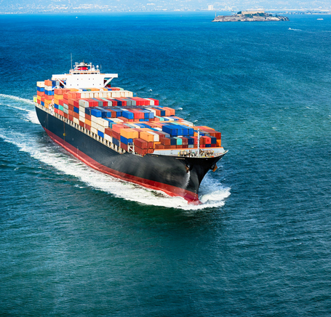
When inland meets ocean

Slide 3
Ground rules
No swearing
No yelling
No excuses
No shoes, no service
No Smoking
No Patriot fans
No deductible buyback
No dogs allowed
No waterborne exclusion
No biting
No loud chewing
No mocking

Slide 4
Agenda
1. PAST | How things came about? How “inland marine” was created
2. PRESENT | Where are we now? Common struggles, managed independently
3. FUTURE | What is to come? Emerging Issues with mutual impact

Slide 5
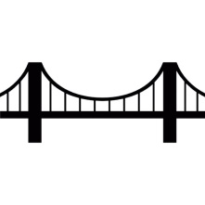
The advent of inland marine
“There was no definition of what constituted a transportation risk, and the imaginations of ambitious inland marine underwriters led to some ingenious interpretations.”

Slide 6
Ocean marine
Customer Centricity
Multi-Line Approach
Concentrated Segments of Risk

Slide 7
Marine and Property
Stock Throughput
Modelling
Commercial Output Policy (COP)
Distribution Trends
Regulation
Treaty Reinsurance Structures

Slide 8
Value & Direct Physical Loss
Fear Of Loss | Market Value | Trade Disruption | FSMA | Warranty
Diminished Value | Brands & Labels | Product Liability Laws | Repairing back to “new” | Constructive Total Loss

Slide 9
coverage
We cover “direct physical loss”
We cover all risk of “direct physical loss”
Are they different? Are you providing an unintended additional exposure risk versus actual loss?

Slide 10
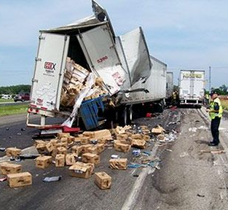
Today’s Policy Language
FEAR OF LOSS It is understood and agreed that in case of damage, or if the assured reasonably suspects damage may exist, to merchandise insured under this policy, the assured is to retain full and absolute discretion and control over the disposition of all such merchandise. It is understood that the assured shall be the sole judge as to whether disposal or sale of such merchandise is detrimental to its interest. It is further agreed that the assured shall have absolute control over all reprocessing and repairs to any damaged merchandise.
Any merchandise which the assured deems unfit for sale or which is unable to be sold or disposed of under its agreement with any entity shall be treated as a constructive total loss.
CONTROL OF DAMAGED GOODS
After Covered Cause of Loss to Covered Property, reconditioning, salvage and disposition may be determined by you at your sole option and we will pay those additional damages accordingly. Also, if prior to a loss, you are a party to an enforceable written contract that grants another the right to determine the disposition of damaged or undamaged Covered Property that was lost or damaged by a Covered Cause of Loss, we will pay any such damages accordingly. This coverage does not apply unless stated in the Declarations as “Included”.

Slide 11
Blockchain
Allows peer-to-peer communication interface without the requirement of an intermediary
With Direct Ledger Technology, the communication of information between parties can be simplified and conducted at extraordinary speed compared to traditional methods

Slide 12
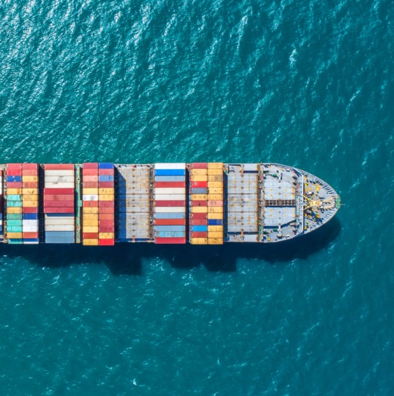
Blockchain Ocean marine
1.
ocean cargo submission
BIG DATA
2.
get exact details of every shipment of every item from value to origin to destination to vessel name to consignee to commodity description and so on
3.
set pricing, terms and conditions

Slide 13
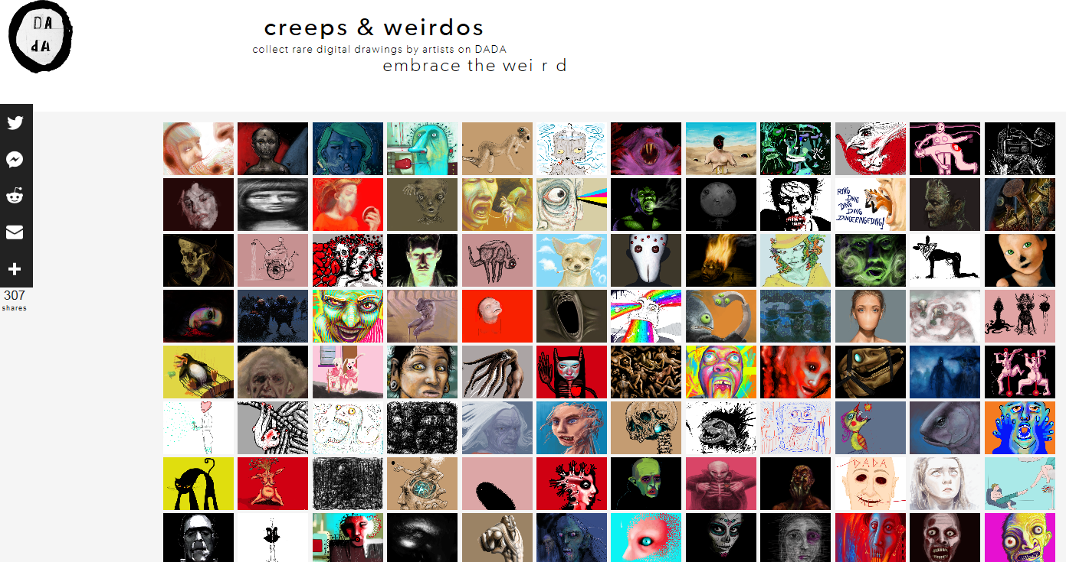
Blockchain inland marine
https://dada.nyc/artgallery

Slide 14
Blockchain inland marine

Slide 15
trucking
Blockchain in Motor Truck Cargo
Central Analysis Bureau: industry-leading products for in-depth motor carrier analysis

Slide 16
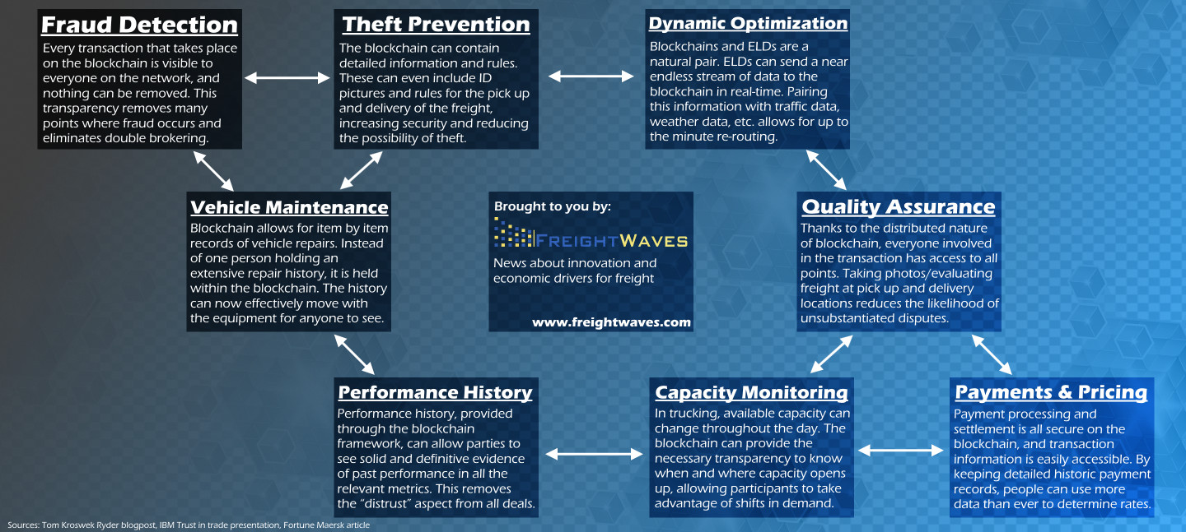
Blockchain Use Cases: Trucking industry

Slide 17
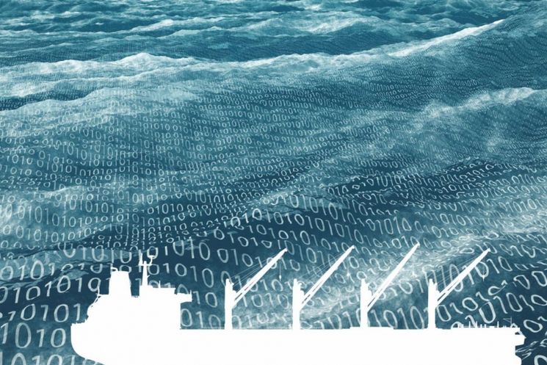
cyber
MARITIME INCIDENTS
A hacker caused a floating oil-platform located off the coast of Africa to tilt to one side, thus forcing it to temporarily shut down
Hackers infiltrated cyber systems in a port to locate specific containers loaded with illegal drugs and remove them undetected
Somali pirates employed hackers to infiltrate a shipping company’s systems to identify vessels passing through the Gulf of Aden with valuable cargoes and minimal on-board security. This led to the hijacking of at least one vessel
Denial of service attacks (initiating a very high number of requests to a system to cause it to cease operating) against ports have been reported

Slide 18
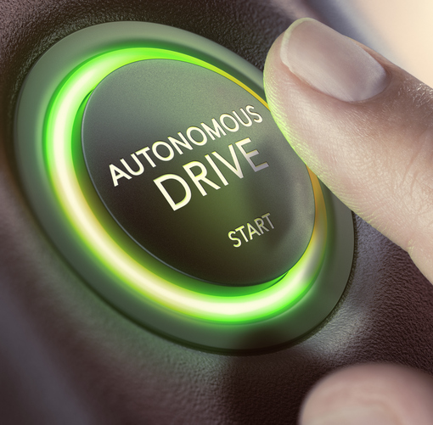
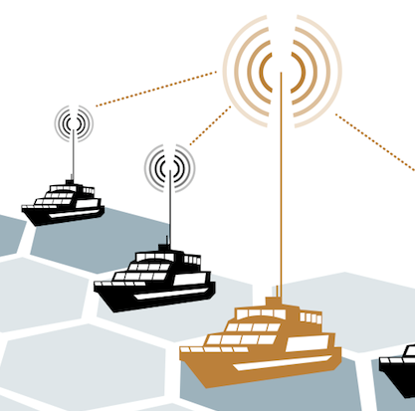
summary

Slide 19
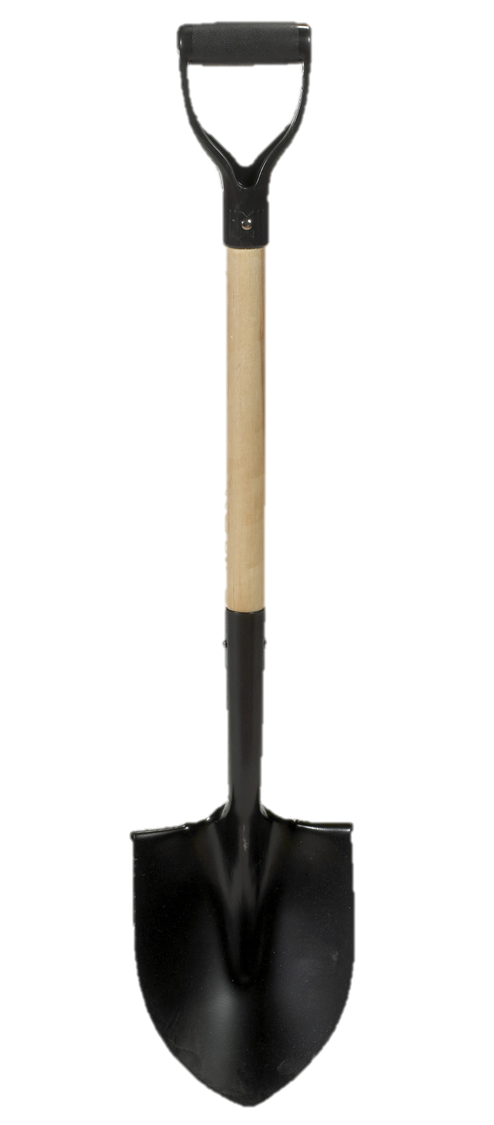
thanks

