Slide 1
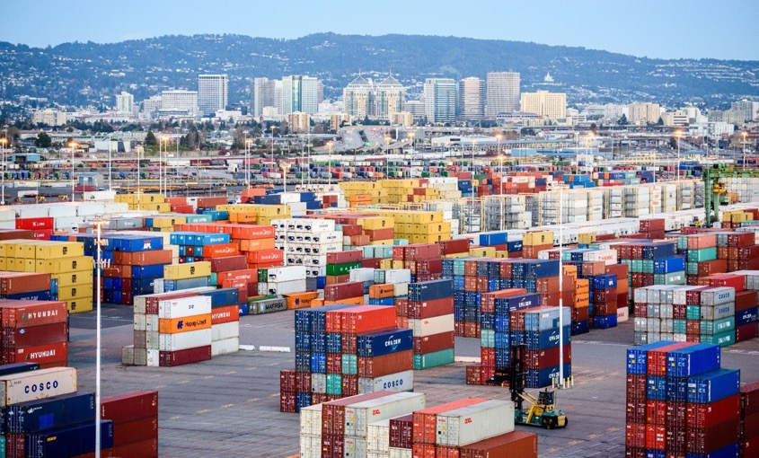
A Better Way Forward
Chris Lytle
Executive Director, Port of Oakland
Board of Marine Underwriters of San Francisco
May 3-4, 2018

Slide 2
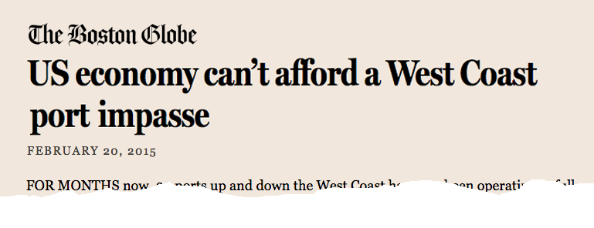

Slide 3
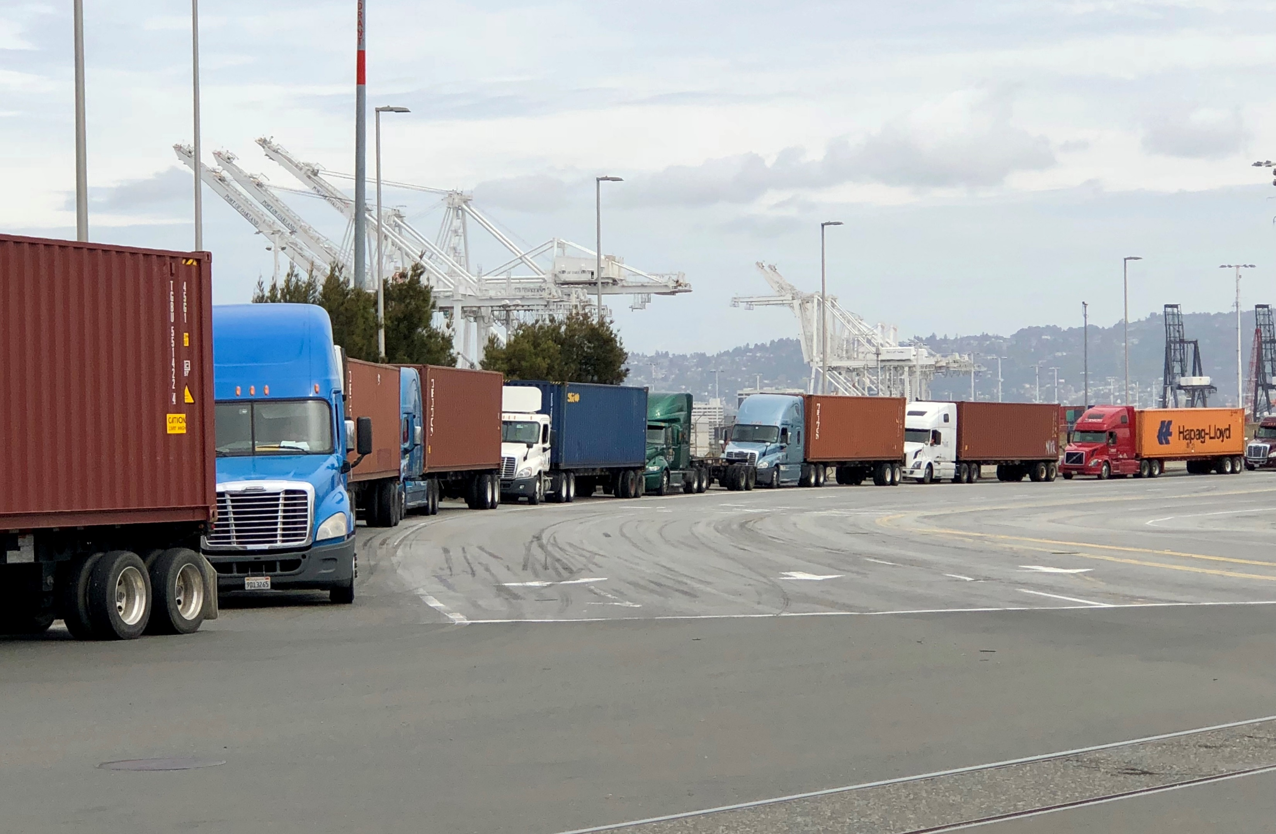
Labor impasse: A world of hurt

Slide 4
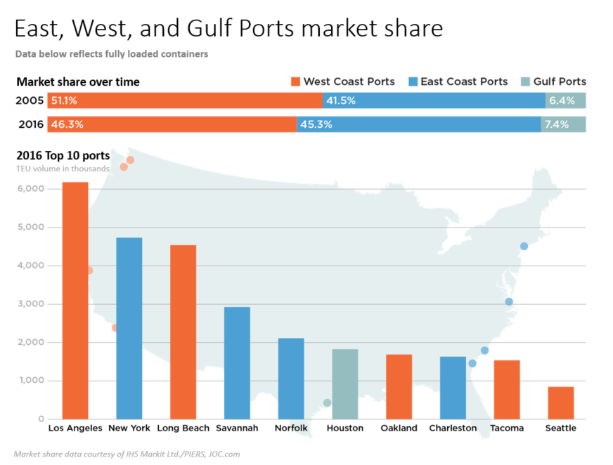
Competition

Slide 5
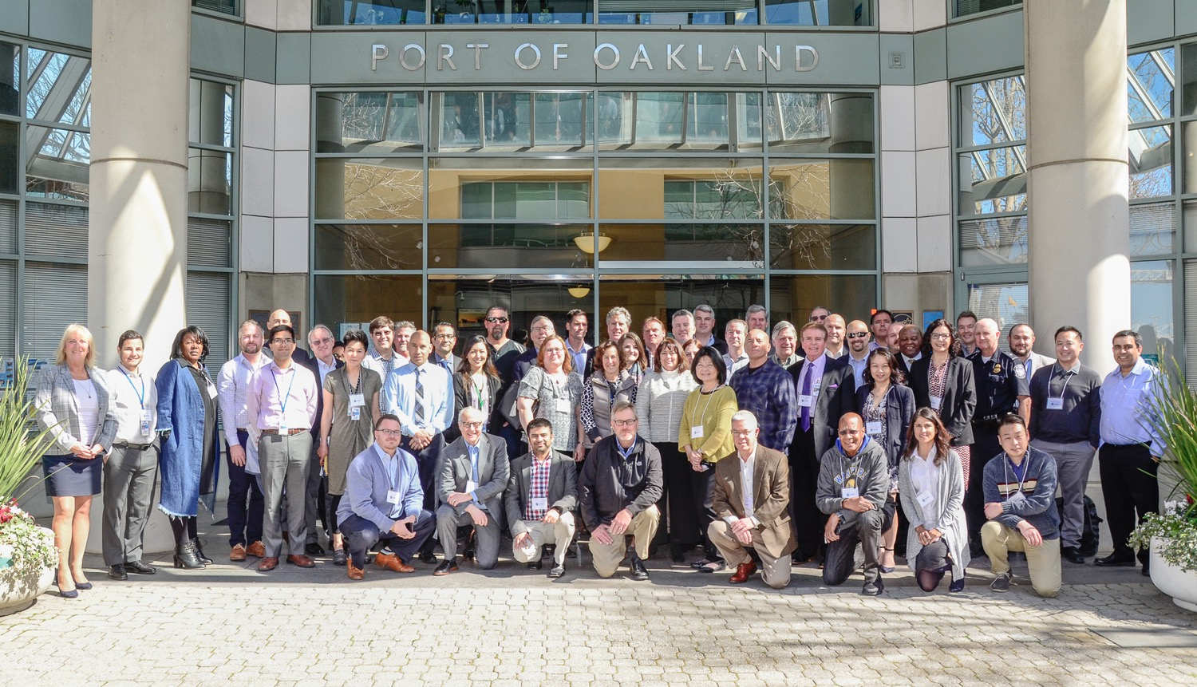
Got to be a better way

Slide 6
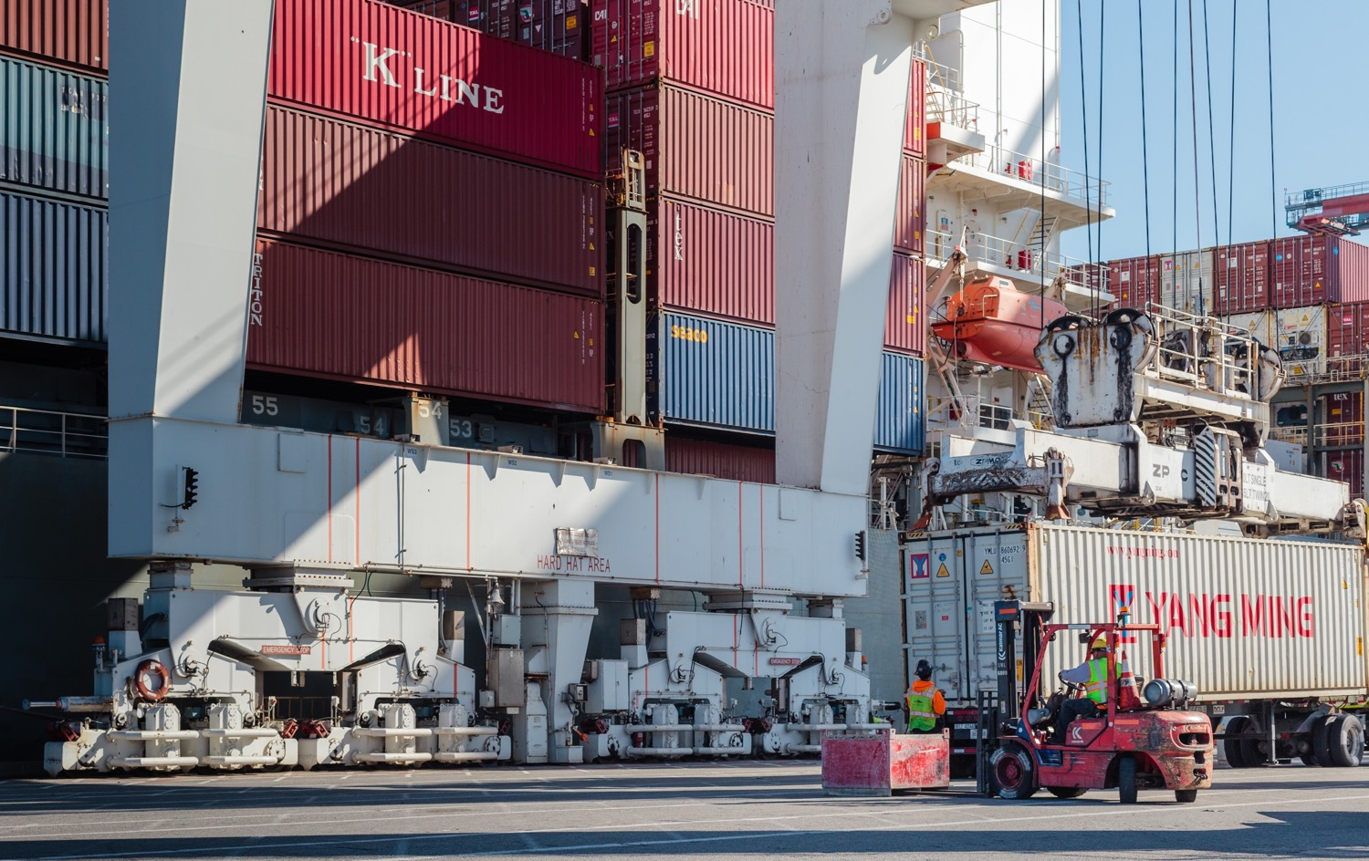
Labor/management take first step
PMA/ILWU contract extension
USMX/ILA re-visit an extension— contract expires Sept. 30, 2018

Slide 7
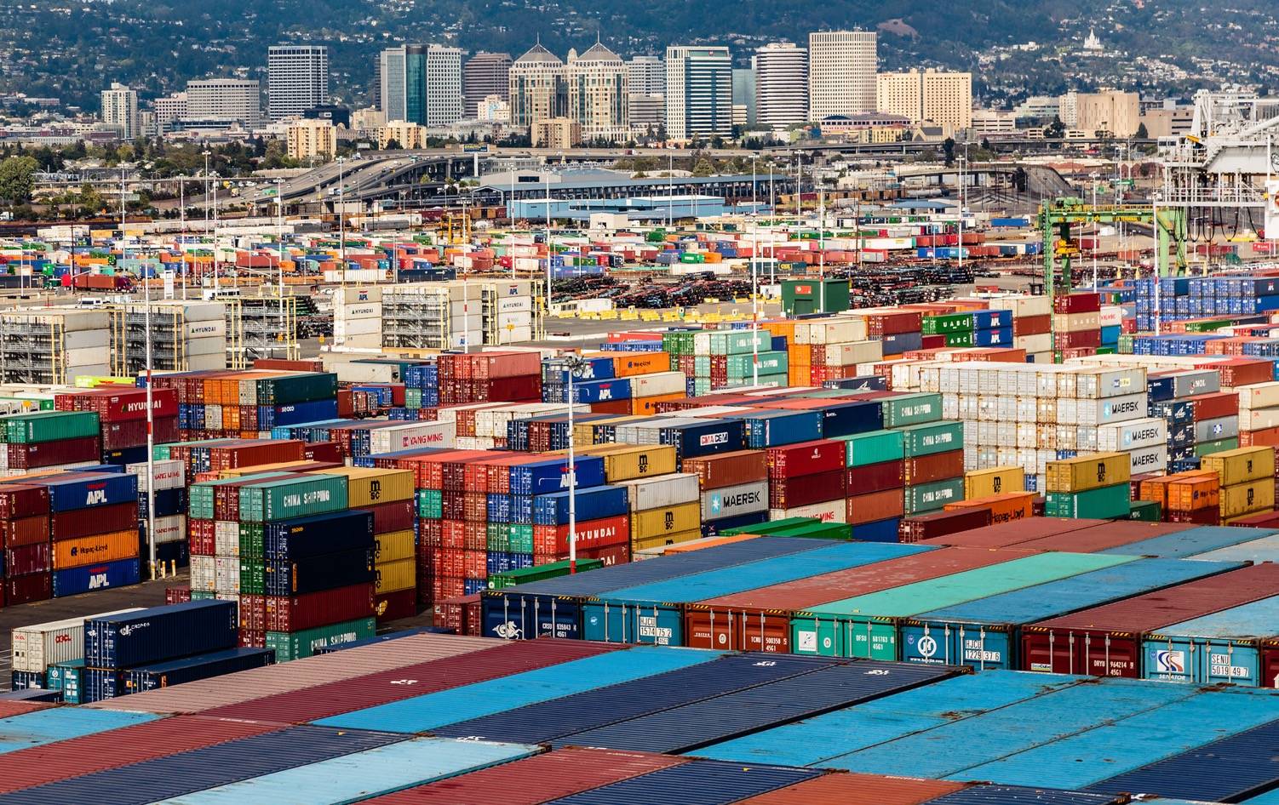
Not your father’s Port of Oakland anymore
Night gates
Appointments
Turn time metrics

Slide 8
Principle of financial discipline
Revenue growth + Expense control + Taking advantage of opportunities =
Record revenue: $358.7 million
Record volume (imports, loaded, total containers)
Bond refinance saves $43 million
Moody’s upgrade

Slide 9
Investing in the Port’s future
$500 million in grade separation, intelligent transportation system & traffic circulation improvements
$100 million in rail manifest & support tracks
$93 million to raise/purchase cranes
$90 million in Cool Port
$50 million in TraPac terminal
$47 million in Seaport Logistics Complex
$25 million in Oakland International Container Terminal
$25 million in Ben E. Nutter Terminal
$800+ million
Notes:
Deciding where to invest and what to invest in. Drivers are anticipated growth markets, such as agriculture and ongoing demand for high quality ag products in Asia.
Balanced port
2016 Exports – 1,258,178 TEUs – 53%
2016 Imports – 1,111,463 TEUs – 47%
Loaded exports up 10.5% in 2016
Ag accounts for 53% of all exports through Port of Oakland. Of that:
California accounts for 70% of ag exports via Port of Oakland – 2.7 million metric tons
73% of ag exports destined to Asia with 12% headed to Europe
Japan is largest recipient of ag exports from Oakland – 22% and over 855,000 metric tons. This is driven by protein producers in the mid-west.
Crane Investments:
Increasing height of 6 ship-to-shore cranes at OICT and 2 at TraPac in 2017 to serve Ultra Large Container Vessel (ULCV)
OICT/SSA is evaluating the purchase of 4-6 new cranes in 2018

Slide 10
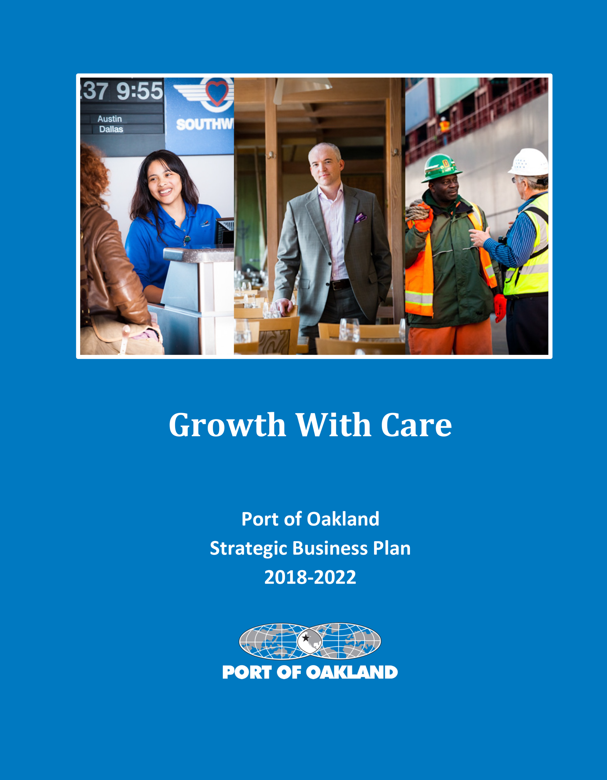

Slide 11
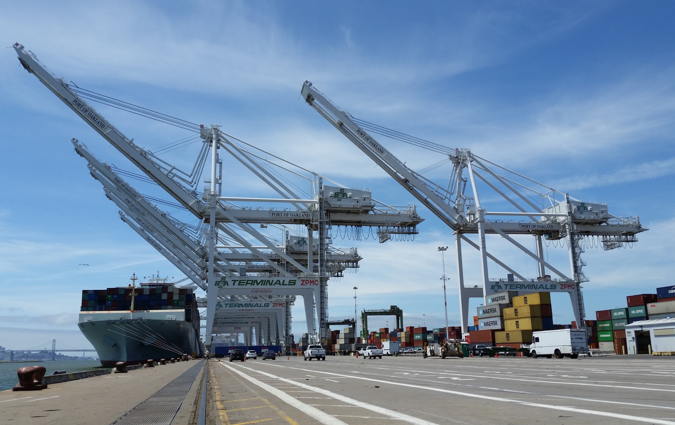
Keys to growth No. 1: Big ship-ready
Six cranes raised
Six new cranes to be purchased

Slide 12
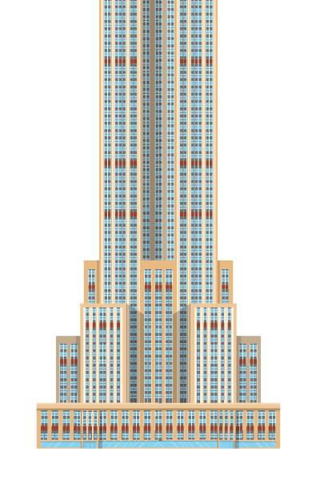
Vessels keep getting larger
CMA CGM Benjamin Franklin
(1,310 feet)
Empire State Building
(1,250 ft)
1,000 feet

Slide 13
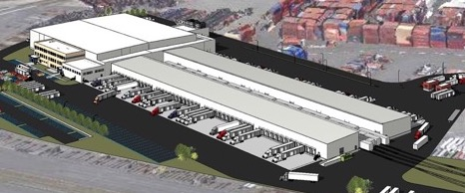
Keys to growth No. 2: Ag exports
$90 million project
50,000 TEUs annually (beef, pork, poultry)

Slide 14
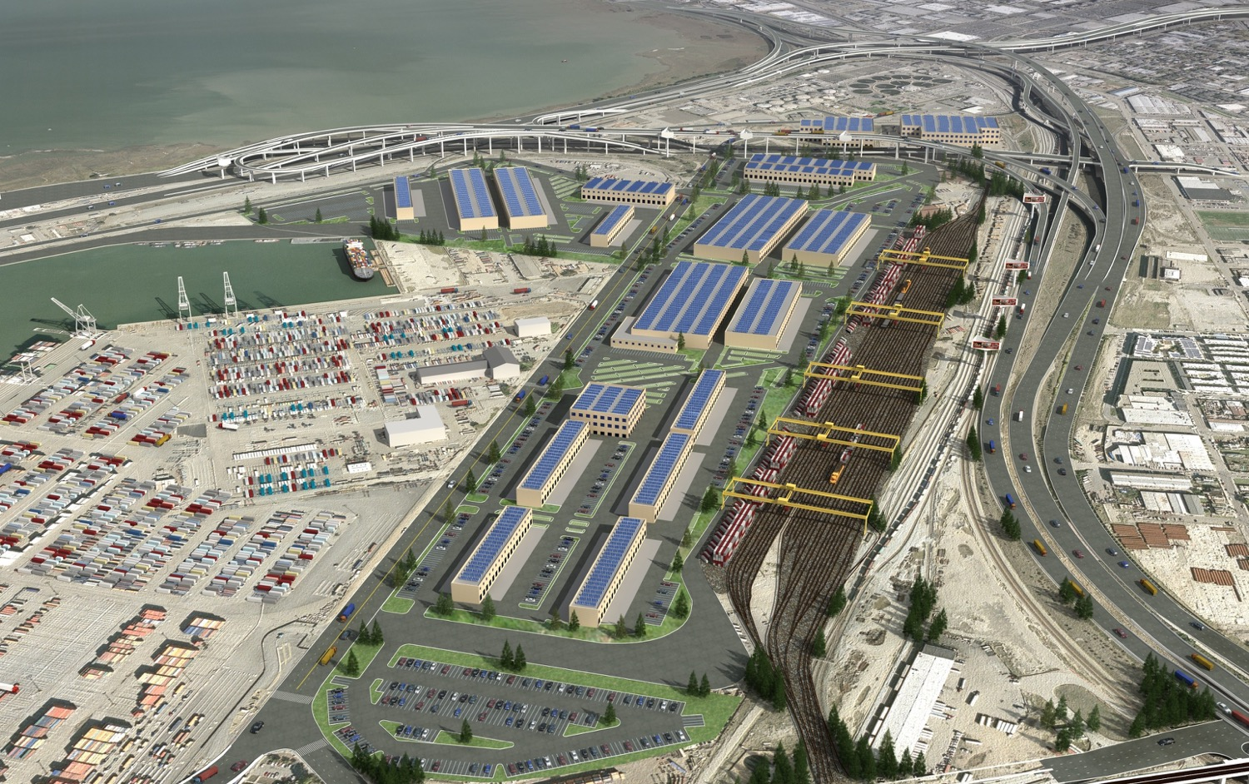
Keys to growth No. 3: More imports
Distribution center within Port footprint
Next to rail/docks
Faster, cheaper, more efficient

Slide 15
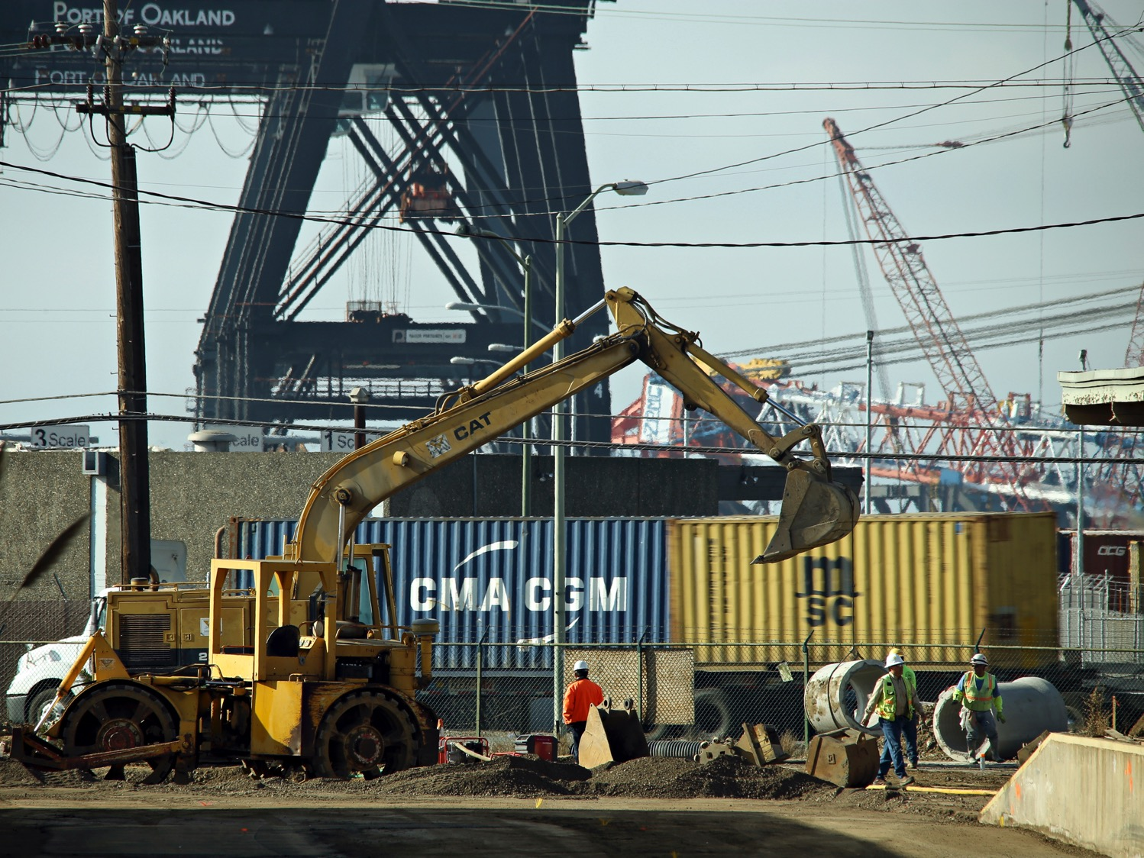
Port of Oakland generates 73,000 jobs

Slide 16
Road to a zero-emission Port
dffdgg

Slide 17
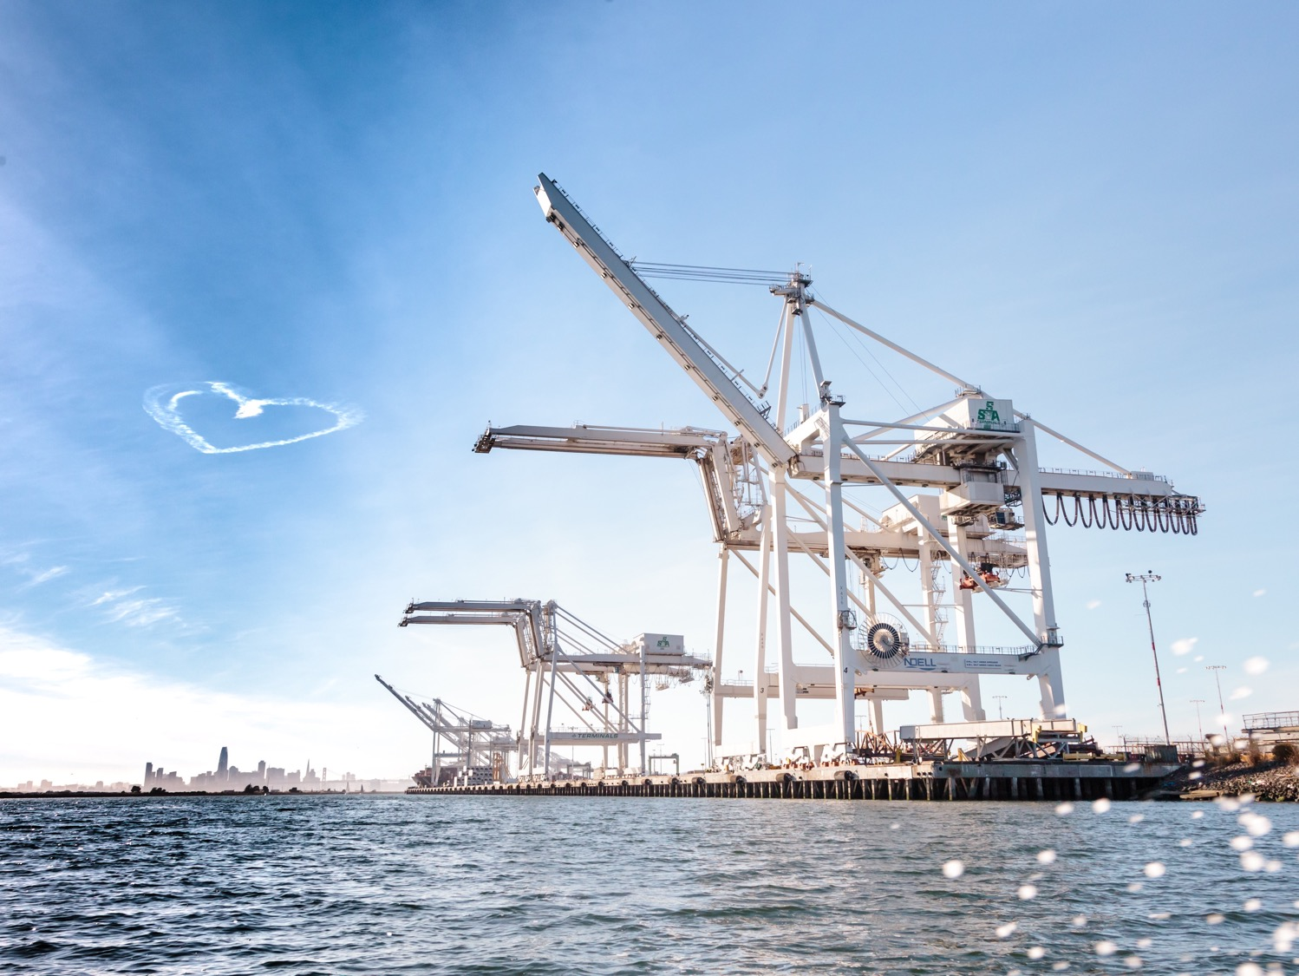

Slide 18
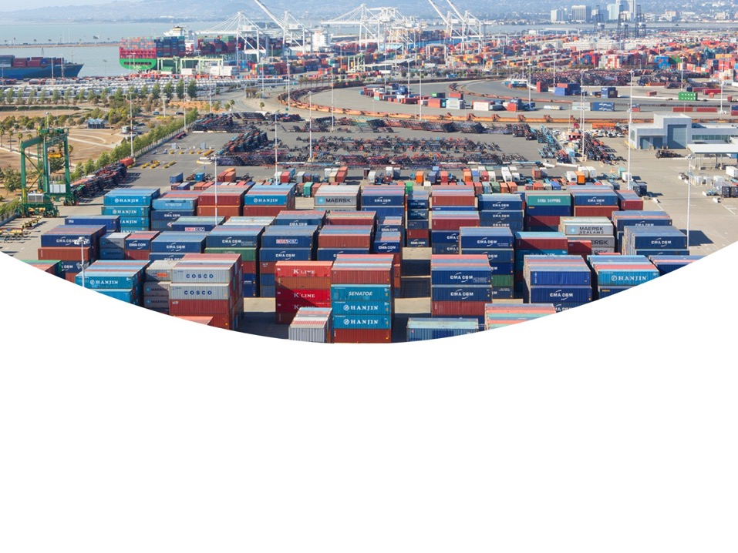
Market share data courtesy of IHS Markit Ltd./PIERS, JOC.com

