Slide 1
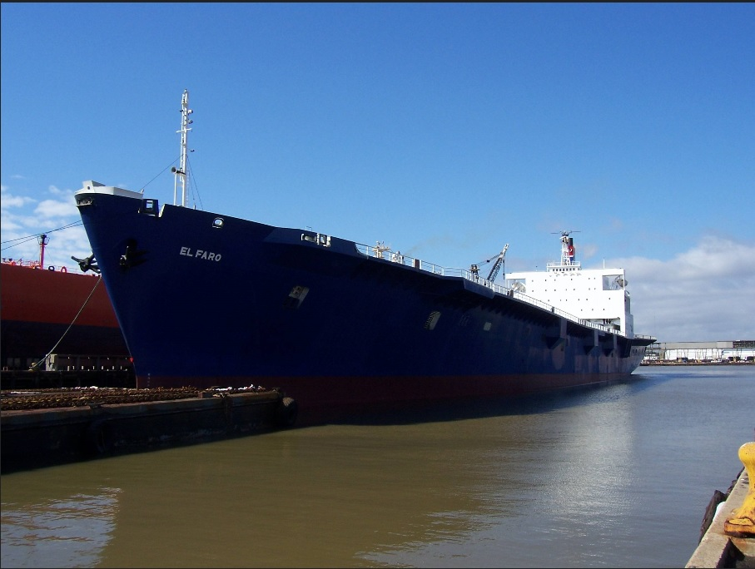
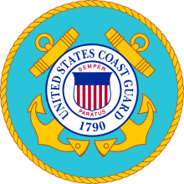
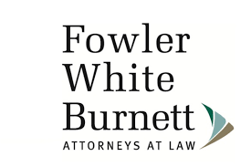


Loss of S/S EL FARO
Anatomy of the Response to a Tragedy
2018 BMUSF
Semiannual Seminar
Notes:
[Picture links to YouTube Underwater Video]
Panel Introduction
Geoff Robb: Mr. Robb's is a Partner at Gibson, Robb & Lindh, LLP. He has 27 years of trial, appellate and arbitration experience emphasizes marine and landside insurance defense as well as cargo and property subrogation claims. Mr. Robb is frequently called upon to advise insurers on coverage questions and investigation. He has advised marine insurers on issues related to Cargo, Yacht, Hull, P&I, Ship Repairers and Marine General Liabilities, and he has defended coverage and bad faith litigation arising under those coverages. He has advised non-marine insurers on issues related to CGL coverage, including broad form coverage for personal and advertising injury, and has litigated related disputes.
Jeff BrayMr. Jeff Bray is the Deputy, office of Maritime and International Law at Coast Guard Headquarters in Washington, DC. This office is comprised of over 35 attorneys, both military and civilian, and provides legal advice and support in areas of prevention law, response law, environmental law, and international law. This office also provides legal support for Coast Guard participation in IMO committees and subcommittees, as well as Arctic Council working groups and task forces. Mr. Bray has served in this position since 2017.
Jerry Hamilton: Jerry is a Board Certified Civil Trial Lawyer. He has been nationally recognized as one of the Top Ten Defense Lawyers in the United States by one of the largest insurance companies in the world. He is a Fellow of the Litigation Counsel of America, an invitation-only trial honorary society composed of less than one-half percent of lawyers in The United States.
Jerry is also Board Certified in Maritime Law, has been recognized as a “Super Lawyer” by Law & Politics every year since 2006 and is named as one of Florida’s “Legal Elite” by Florida Trend. He has been selected as one of America’s Top 100 High Stakes Litigators® for 2018— this is by invitation only and is reserved to identify the nation’s most exceptional trial attorneys in high value, high stakes legal matters.
.
Mike Holt: Mr. Holt is General Counsel, SVP, and Chief Ethics Officer at TOTE. He has served in the ocean transportation and logistics industry for over 20 years. He joined TOTE in late 2011, and was previously the General Counsel and Chief Compliance Officer for NYK Group Americas Inc. (NGA). He designed and implemented the NGA Compliance Program, created the NGA Code of Ethics and was responsible for all of the compliance officers in the NGA group companies. His work for NYK led them to be selected as one of the World’s Most Ethical Companies by Ethisphere for four consecutive years, 2008, 2009, 2010 and 2011. In his role at TOTE, Holt is also responsible for overseeing all legal matters for TOTE’s independently managed companies. IN 2018 TOTE was selected as one of the World’s Most Ethical Companies
Allan Kelley: Mr. Kelley is a shareholder at Fowler White Burnett. He’s practiced maritime law with the firm for 38 years. He has served on the firm's Management, Hiring, Long Range Planning and Pension Committees. He regularly represents all areas of the marine industry, including major cargo carriers, cruise lines, commercial vessel owners, operators and charterers, pleasure vessel owners, marina operators, terminal operators, related marine interests and their insurers and the insurance industry, protection and indemnity, hull and machinery, legal liability, cargo and inland marine policies.

Slide 2
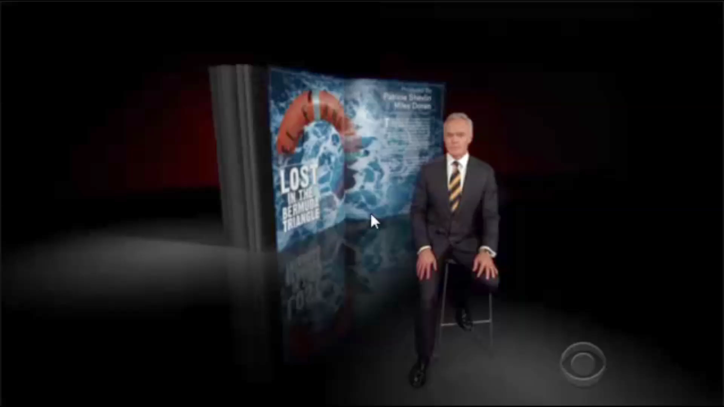
60 Minutes Segment On El Faro

Slide 3
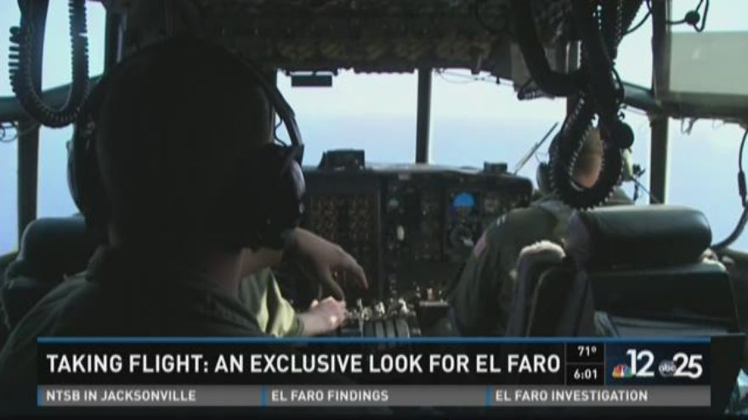
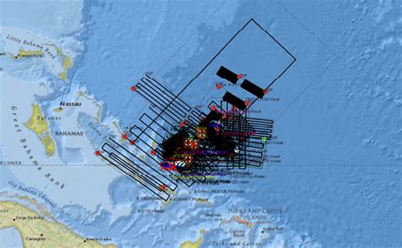
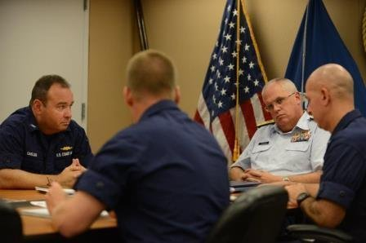
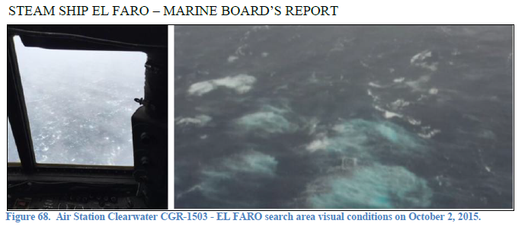
U.S. Coast Guard
The Search
Coast Guard Officials Planning the Search
Search Conditions
7th Coast Guard District Leadership
Planning the search for El Faro
Notes:
[BUILD SLIDE – Timeline is below the graphic]
Click: Photos fade out
Timeline is behind the pictures
JEFF BRAY: Overview of the Coast Guard search
Tues. 09/29: 2010 El Faro departs Jacksonville with 33 POB.
Wed. 9/30: Captain email to Tote
Thur. 10/01: 0720 El Faro’s last communication via inmarsat
The Captain reported:
Vessel had lost propulsion.
Vessel experienced water ingress into a cargo hold through a scuttle (small opening to allow crew access into a hold).
Crew had secured the scuttle and was successfully pumping out the water from the hold.
Vessel was experiencing a 15 degree list but it was unknown whether it was a result of water ingress or the weather conditions.
U.S. Coast Guard notified and makes attempts to contact the vessel.
Fri. 10/02: Coast Guard assets search for the El Faro; no trace found.
Sun. 10/04: Coast Guard finds a large debris field.
Mon. 10/05: Coast Guard reports finding remains in survival suit.
Tues. 10/06: NTSB begins investigation into the sinking.
Wed 10/07: Coast Guard suspends search at sunset.

Slide 4
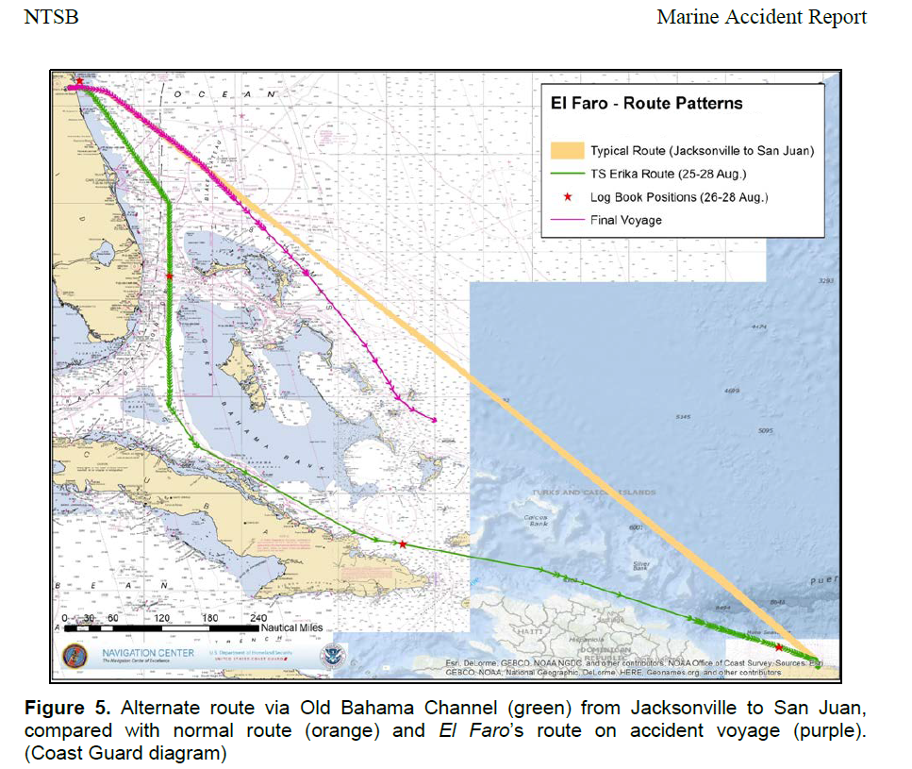
Routes to San Juan
Notes:
GEOFF ROBB
TPs:
The Captain had an additional route option in addition to the straight route between Jacksonville and San Juan for his transit:
Transit south through the Straits of Florida then through the Old Bahama Channel (runs between Cuba and the Great Bahama Bank).
Three routes depicted here:
The normal Jacksonville to San Juan route
The route taken by El Faro on her final voyage
The Florida Straits/Old Bahama Channel route.
According to MBI testimony from TOTE company officials their vessel Masters:
Have total responsibility for all voyage planning and routing decisions.
Operate autonomously, and are free to choose whichever route they feel is safe.
Are the experts in the safe operation of the vessel which includes voyage planning elements that would be associated with evaluating environmental conditions.
Are the “nautical experts” within TSI.
Do not need permission to change the vessel’s route.

Slide 5
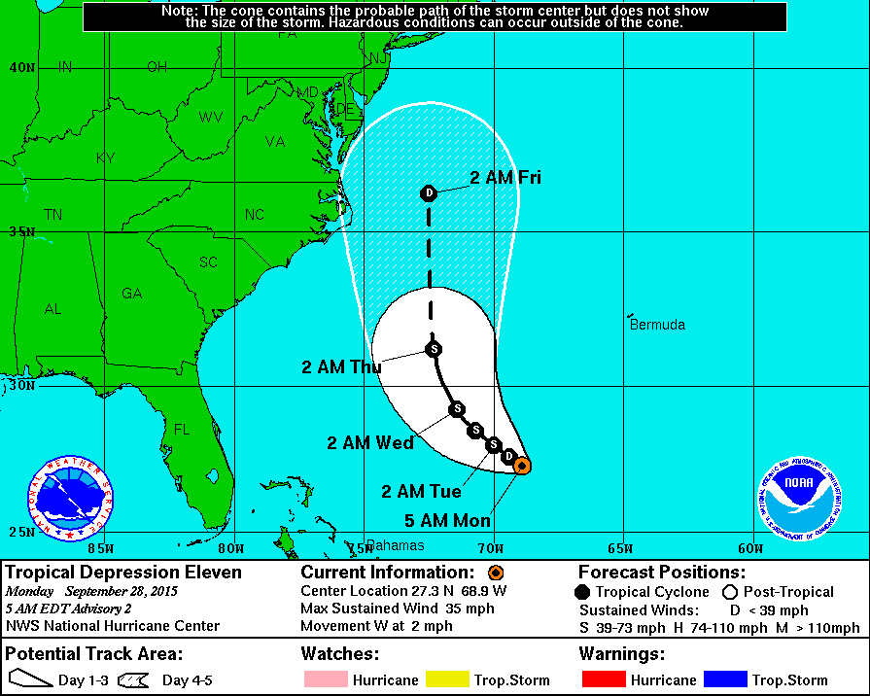
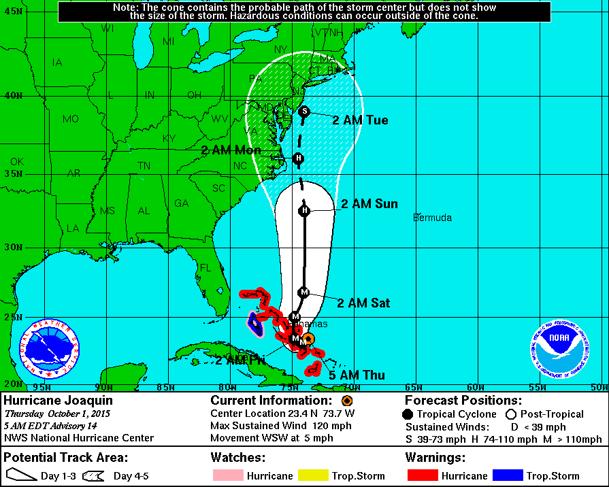
Heavy Weather Forecasting Issues
28 Sep (0500 EDT) TD Joaquin
forecast & position
01 Oct (0500 EDT) Hurricane
Joaquin forecast & position
Notes:
GEOFF ROBB
TPs:
Hurricane Joaquin had one of the largest error forecast rates in NWS history. The two forecasts highlight the disparity in direction and intensity between forecasts and reality.
The 28 Sep forecast (the day prior to departure of the EL FARO) indicates that Joaquin would be a TS on Thursday morning (01 Oct) somewhere off the coast of South Carolina). The red star on the 28 Sep graphic represents the approximate position of the storm for the date and time the EL FARO sank (01 Oct 2015, 0740 EDT)
In actuality, the 01 Oct 0500 forecast on the right shows that Major Hurricane Joaquin was off the east coast of the Bahamas on the morning of 01 Oct.
The NWS after action report on Joaquin indicated that record high September 2015 water temps east of the Bahamas helped Joaquin form into a rare October major hurricane (the most intense ever recorded for October since monitoring began in 1866). The fact that the storm did not form in a subtropical region contributed to the forecasting difficulties. The NWS also does not increase their forecasting watch standers for storms that are not predicted to make U.S. landfall and extra resources were not brought in for Joaquin until after the EL FARO’s sinking.
As a result of the loss of EL FARO, U.S. Committee on the Marine Transportation System, an inter-agency committee authorized to coordinate policies affecting the U.S. Marine Transportation System stood up a Extreme Marine Weather Task Force and the CG is an active participant.

Slide 6
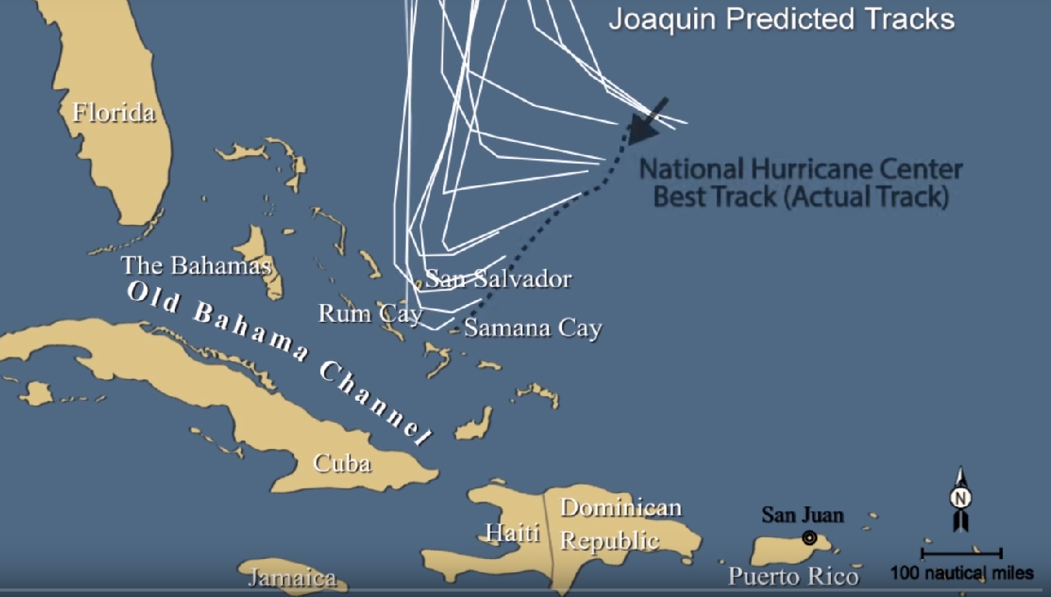
Notes:
[HIDDEN SLIDE – Inserted for awareness]
Per the NHC Branch Chief for the Hurricane Specialist Unit in the MBI Hearing:
The initial forecast for Joaquin had errors that were much larger than normal.
So for example the 3 day forecast that would have verified the morning of October 1st had a track error…it was 536 miles.
That’s an extraordinarily large area. That’s really about 1 in 100 type of track error.
The 48-hour track forecast that verified at the same time had an error of 180 miles and that’s something like a 90 or 95th percentile of error. So it’s certainly a very large error.
By the time one day it was a 62 mile error, the 1 day forecast was verified at 8:00 AM and that’s more in line, at least close to what the average was. So the earlier forecast, track forecast had errors that were much larger than normal for us.
The same was true with the intensity errors.
The 3 day intensity error that verified at that time was 80 knots too low.
The 2 day forecast that verified at that time was 60 knots too low.
And the 1 day was 30 knots too low.
So the . . .initial forecast called for a relatively weak system to head off to the west and northwest and this instead it moved west southward and southward and strengthened.
But it kept tracking southwest…

Slide 7
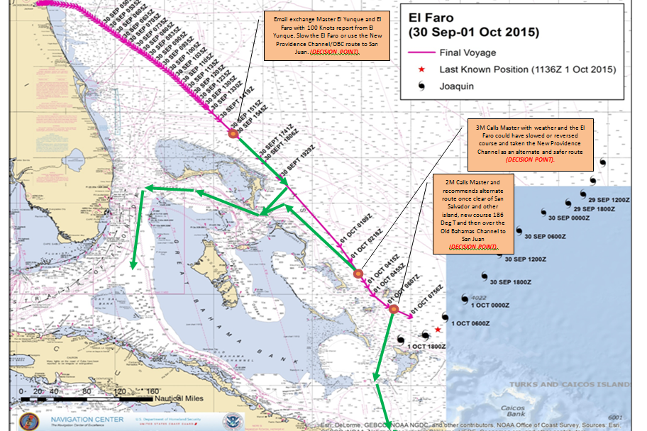
Key Storm Voyage Decision Points
Notes:
[HIDDEN SLIDE– inserted for awareness]
The EL FARO’s master received several personal warnings about the potential for his course to be impacted by Tropical Storm/Hurricane Joaquin prior to departure from Jacksonville, FL on 29 Sep and also while underway en route to Puerto Rico.
As the EL FARO headed southeast towards Puerto Rico TS Joaquin rapidly strengthened to a category 3 hurricane.
Over the course of the voyage there were 3 additional key points where the master received new information and/or warnings from his officers to take advantage of additional points to divert to the Old Bahama Channel (depicted by green arrows on the chart).
EL Faro’s 3/M & 2/M stood the two watches before the accident watch (2000-0000 & 0000-0400) & called the Captain to discuss the forecast & options, but no major course deviations were ordered.
The Captain returned to the bridge at 04:09 am. (VDR Transcript page 365).

Slide 8
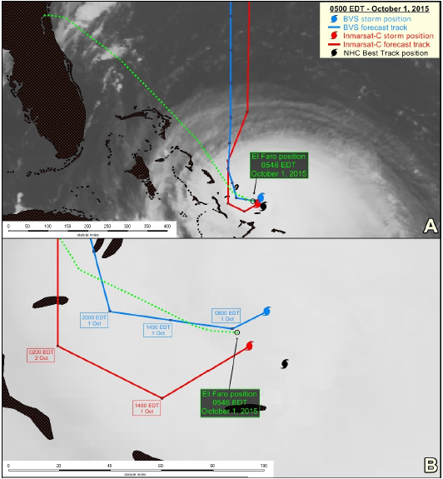
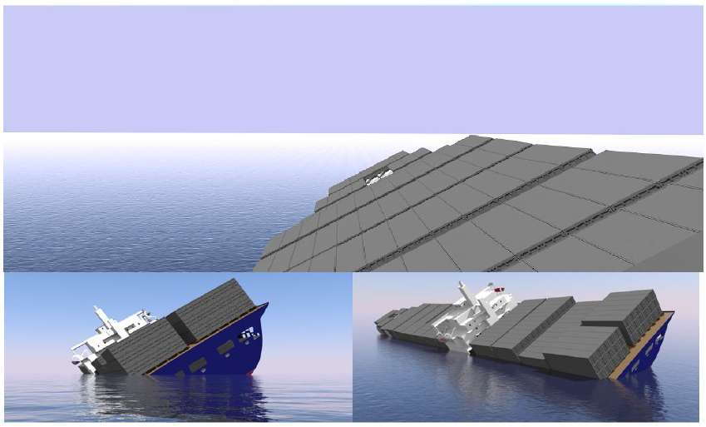
Sinking of the S.S. EL FARO
Notes:
JEFF BRAY
TPs:
On October 1, 2015, at 0739, the VDR on the El Faro stopped recording. The last conversation it recorded was Captain Davidson encouraging an AB to work towards him so they could evacuate the bridge.
El Faro was lost.
The left screen shot is a Comparison of Joaquin’s location and forecast track delivered by BVS main weather files and Inmarsat-C SafetyNET and available to El Faro about 0500 EDT on October 1, 2015. Different-colored cyclone symbols show Joaquin’s location from BVS, Inmarsat-C SafetyNET, and best track data. Green dotted line shows El Faro position. Depictions are overlaid on GOES-13 infrared image from 0515 EDT on October 1, 2015.
The right screen shot is a computer rendering of EL Faro showing the vessel with progressive flooding and wind heel, listing to port at 35 degrees with 5.0 feet aft trim and 37.0 foot draft amidships. The upper illustration simulates a view forward from the starboard side of the navigation bridge which was the assumed location of the vessel Master when the Master makes the “bow is down” statement at 7:30 AM on the VDR audio transcript. Illustration produced by the USCG Marine Safety Center.

Slide 9
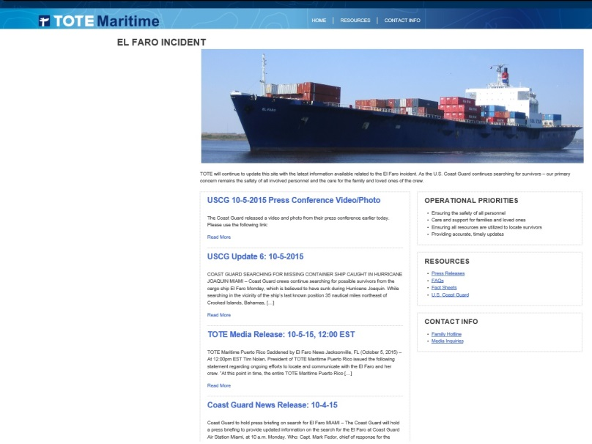
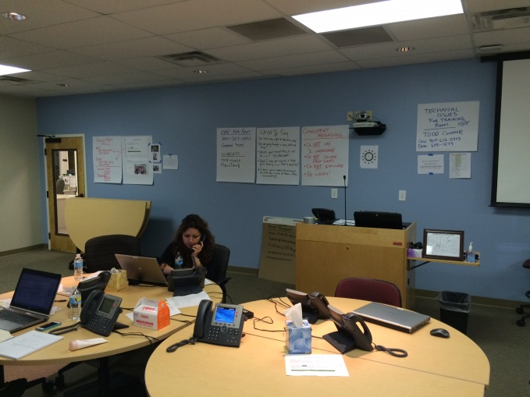
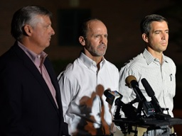
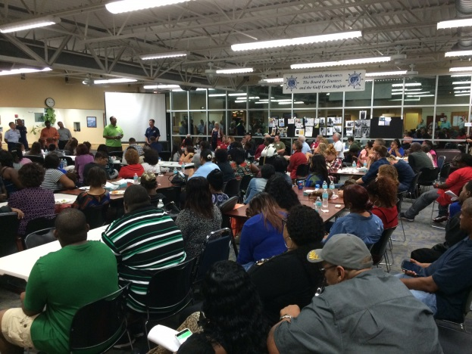
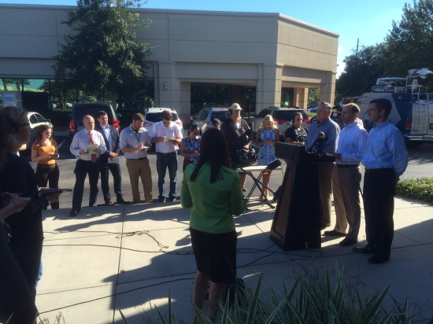
Tote’s Initial Response
Response & initial actions
Addressing immediate questions & concerns raised by crewmembers’ families
Notes:
MIKE HOLT
Recollection of considerations on October 1, 2015 (i.e. once communications were lost with EL FARO)
GC’s response and action taken in the immediate aftermath of a catastrophic event involving employees and organization assets
Deploying officers during the search (e.g. Union Hall, Seventh Coast Guard District)
Addressing immediate questions and concerns raised by crewmembers’ families
Reached out to all the families of the 33 individuals onboard and are in constant communication with them regarding updates on the El Faro.
A 24-hour family hotline and dedicated family website was activated Thursday, October 1.
Set Up Crisis Center for family support
Family members and loved ones were assisted in travel to Jacksonville where in-person family meetings were held.
Twice-daily conference calls with the Coast Guard and family members were held throughout the search.

Slide 10
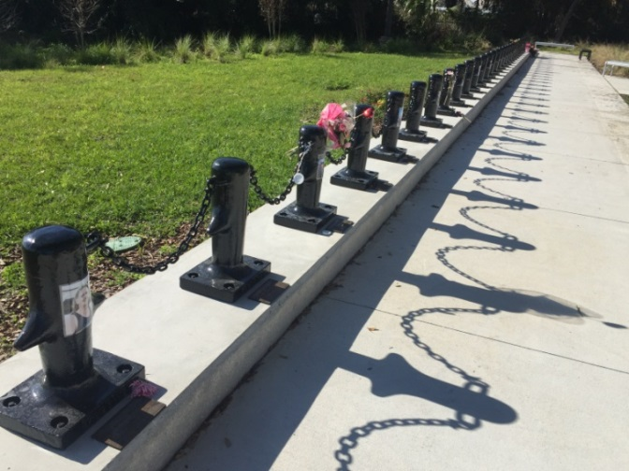
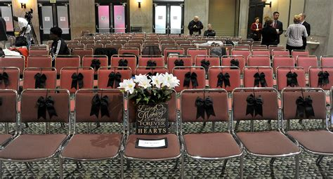
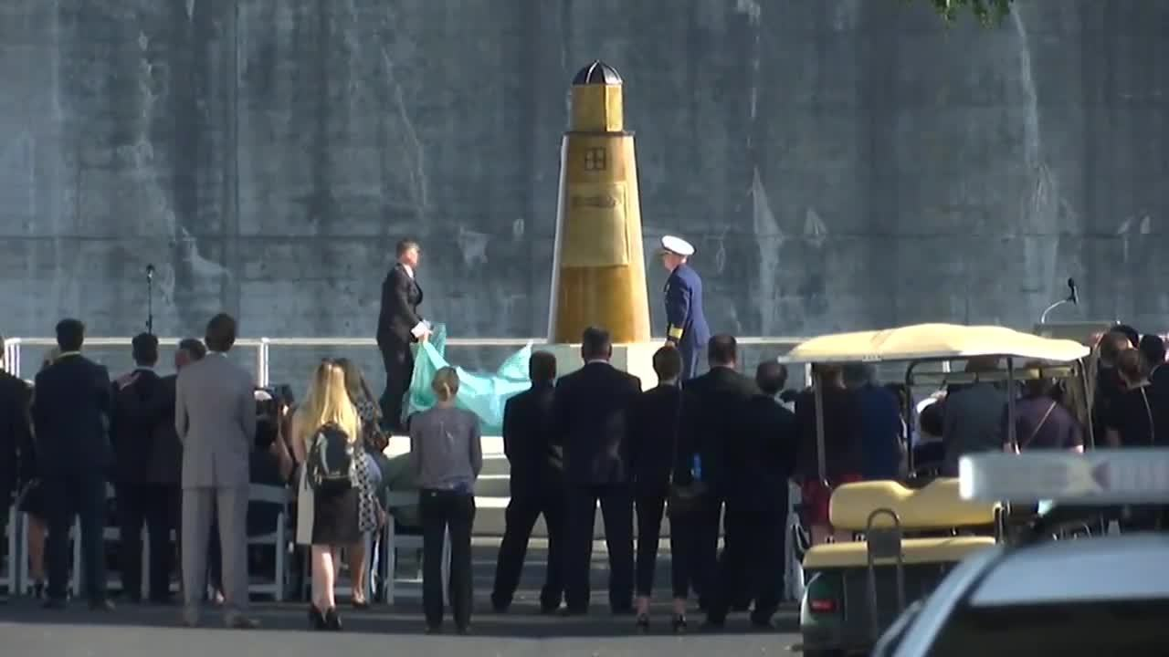
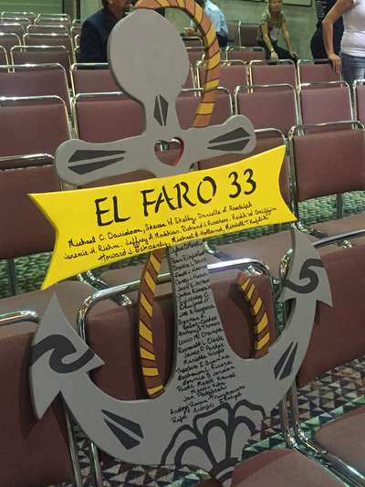
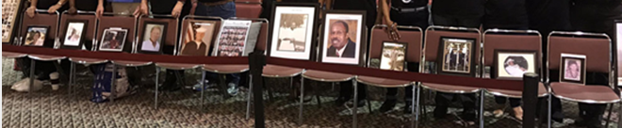
Engagement with Family Members
Notes:
JEFF BRAY / MIKE HOLT
Discuss interaction with family members from their perspective.

Slide 11
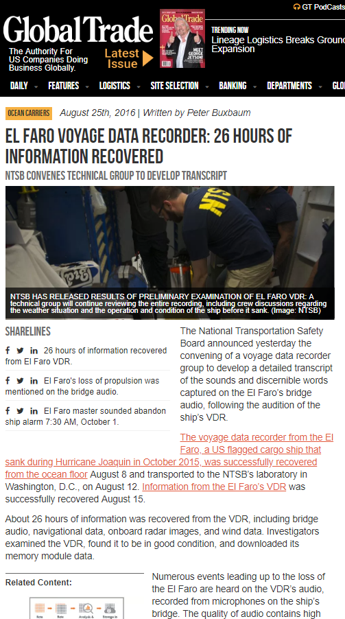
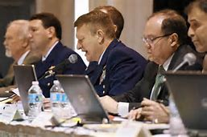
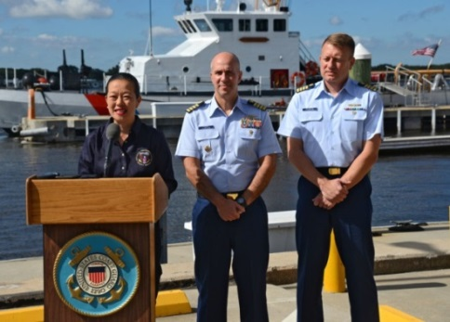
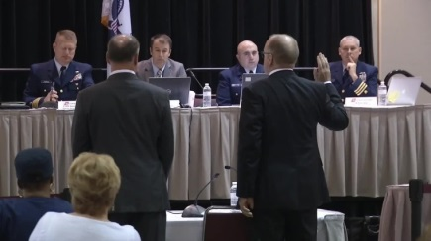
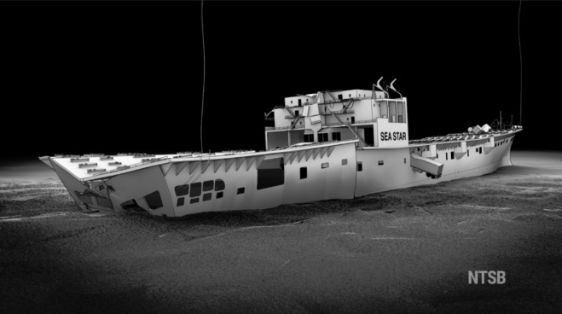
The Coast Guard MBI & NTSB Investigation
Notes:
JEFF BRAY:
Concurrent federal investigations:
USCG convened Marine Board under 46 U.S.C. 6301
Scope of investigation included cause and potential enforcement actions
Lawyers allowed to represent all parties during all interviews
EL FARO was unprecedented in that the CG held MBI hearings during investigation with
NTSB designated as the lead agency.
NTSB investigated under 49 U.S.C. 1131
Designated as lead agency under 49 CFR 850.15(b)(3)
Scope of investigation was limited to probable cause
Lawyers excluded from interviews with exception of witness’ counsel
Primary goal was transparency and fairness
All hearings live-streamed by several media outlets
Met with families prior to formal proceedings
Held group meetings with legal representatives
Constituents for an investigation of this scale of a casualty
Public
Industry
Survivors’ families
Congressional interest/oversight committees
Interaction with NTSB and parties-in-interest
Considerations with multiple parties-in-interest

Slide 12
Organizing the Team
General Counsel
USCG
NTSB
Litigation
Wrongful Death Claims
Litigation
Cargo Claims
Notes:
MIKE HOLT: Filling the tool box & Coordinating the external Legal Team
Guiding the internal Corporate Team
Populating & developing the legal team for multiple fronts – how done?
USCG & NTSB team
USCG MBI
NTSB Investigation
Selecting the Party Representative to NTSB
Responding to Congressional inquiries
Civil Litigation
Witness Prep
Limitation Action
Cargo Claims
Wrongful Death Claims
Communication
Weekly conference calls
In person meetings
“Transparency, Teamwork & Communication”
Information Management
From a general corporate view, need to assemble the broader response team as well:
Operational Response (Rapid Response, Salvage/Tow) –
Emergency Response Plan
Legal
Media
Unions (SIU/AMO)
Insurers
Internal (e.g. Party Representative, Subject Matter Experts, etc.)

Slide 13
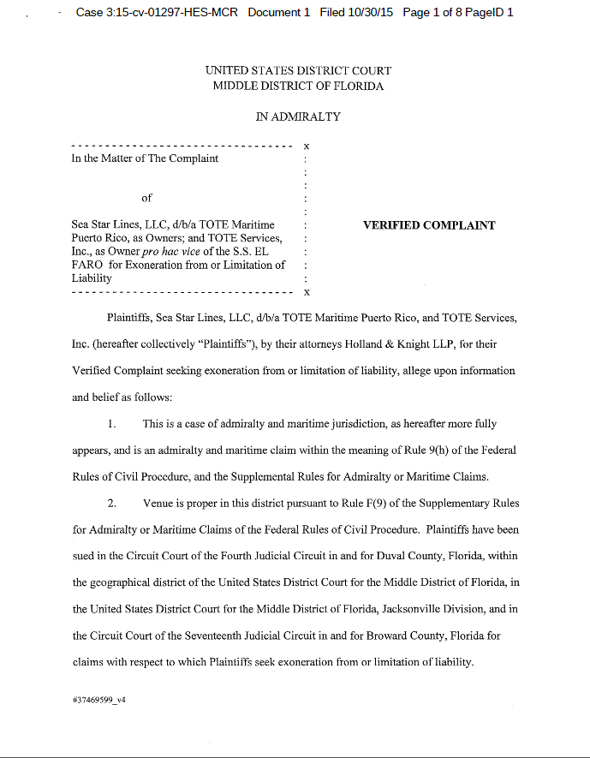
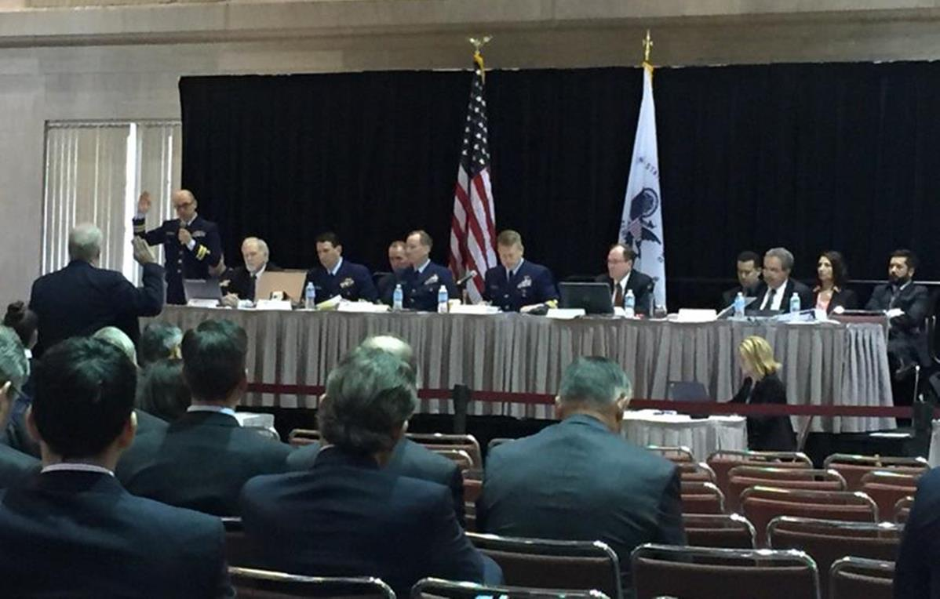
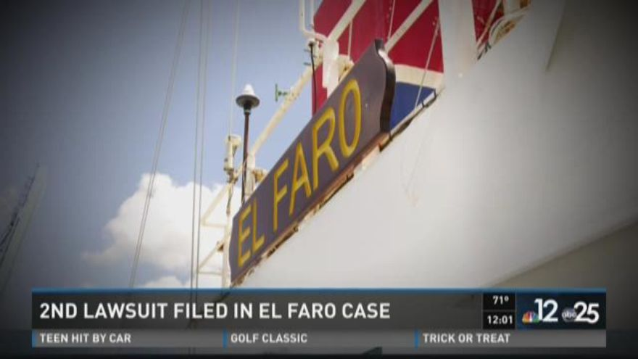
Limitation Action & Government Investigations
Notes:
The Issues
JERRY HAMILTON
Legal Issues
Summary of Civil Litigation
33 Claims from 33 Crew; 600+ cargo claims filed
Limitation of Liability Action - October 30, 2015
Mediations
TSI & TMPR Presidents participated in mediations
All wrongful death claims settled by April 12, 2017
All cargo claims settled by July 11, 2017
Claimant’s Motions to Modify Injunctions / Stay Order
Privity & Knowledge of the Owner vs. Captain’s Defense
Demands of Concurrent USCCG & NTSB Investigations & civil litigation
Management as potential witnesses in the investigations
Meeting the information demands of subpoenas and discovery, while maintaining the business
Finding the VDR—impact on investigation & litigation [will be covered on next slide]
ALLAN KELLEY
Cargo Claims
600+ Cargo claims
Specific issues regarding cargo claims
Specific challenges regarding cargo claims
Settlement negotiations
Cargo loading issues

Slide 14
Limitation Action & Government Investigations (cont’d)
Hidden Slide
See Notes
Notes:
[HIDDEN SLIDE]
JEFF BRAY
Vessel Regulatory Framework
ALLAN KELLEY
National Hurricane Center – Weather Forecasting Details
AWT Litigation
MIKE HOLT
Significant Post-Accident Actions
Settlement Strategy [Not on slide]
33 crew families
$500k for non-economic loss

Slide 15
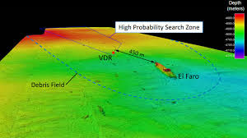
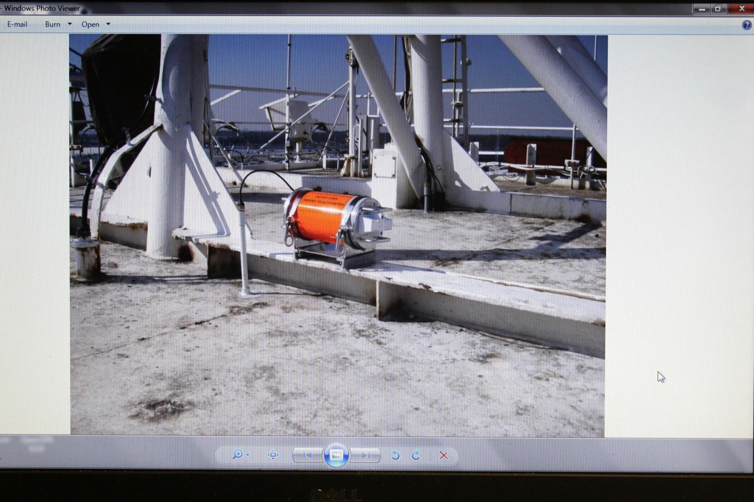
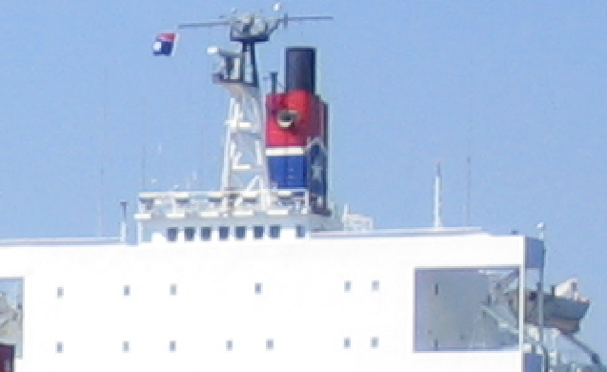
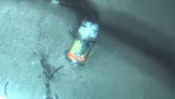
Voyage Data Recorder
Notes:
TPs:
JEFF BRAY
The NTSB spent over $5M to fund three Navy and NOAA missions to locate and document the EL FARO wreckage and retrieve the VDR. The VDR picture at the bottom left was taken by a ROV just prior to recovering the VDR about 450 meters from the main EL FARO wreckage at a depth of 15,000-ft.. The VDR had broken off with the vessel’s mast, which was located during the second NOAA underwater search.
The pictures on the right show where the EL FARO’s fixed VDR was secured above the bridge. EL FARO’s S-VDR was not designed to float free from the vessel.
The Simplified Voyage Data Recorder (S- VDR) proved vital to the NTSB and CG investigations including 26-hours of bridge audio that was used to produce a 508 page transcript – the longest in NTSB history for any mode of transportation. Other types of parametric data were also obtained including thousands of radar screen shots.
Newer VDR models could have provided even more data and they are also designed to float free and double as a back-up EPIRB.
JERRY HAMILTON
Legal Issues related to the VDR

Slide 16
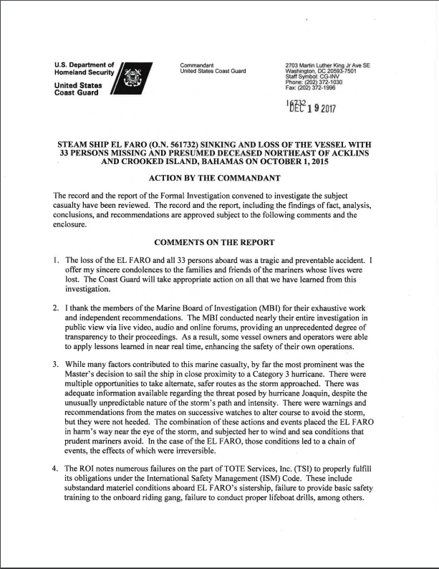
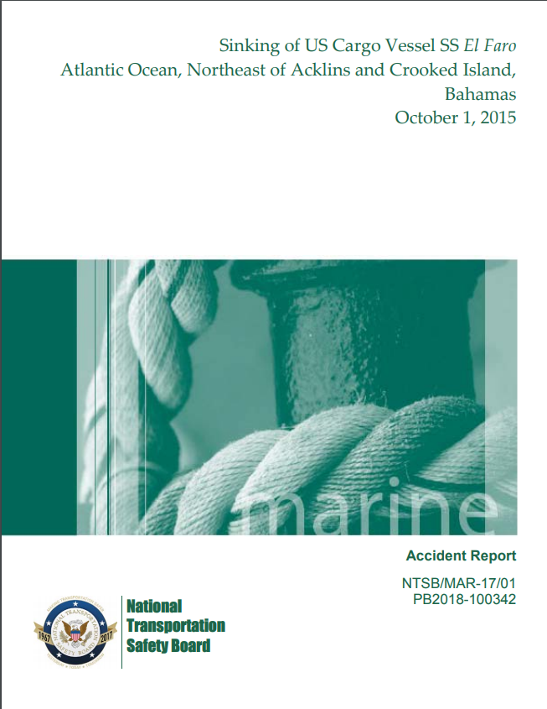
Government Investigation Reports
Articulating the Cause: Release of the USCG & NTSB Reports
Notes:
JEFF BRAY
Determining the cause
The game changer: Impact of finding the VDR (see next page)

Slide 17
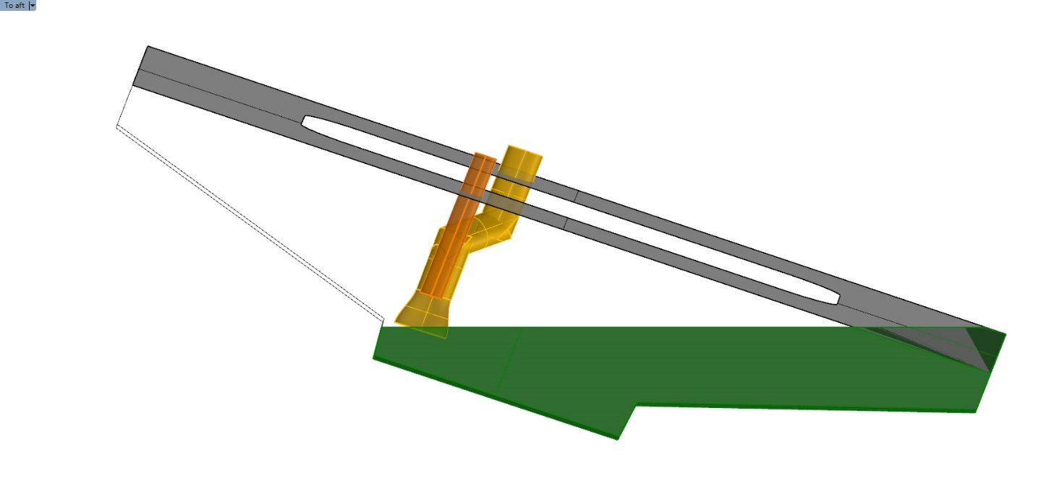
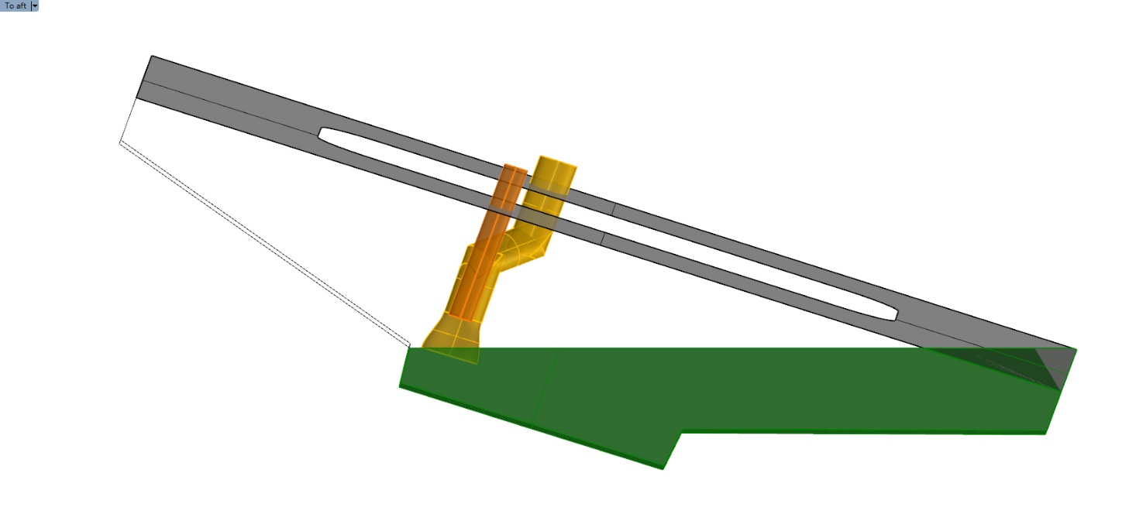
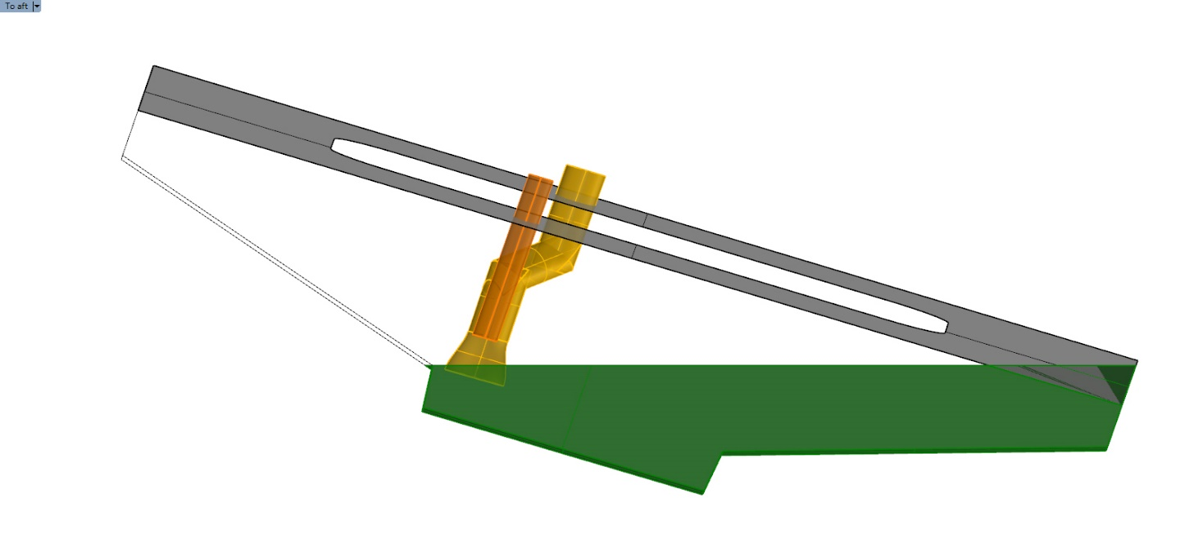
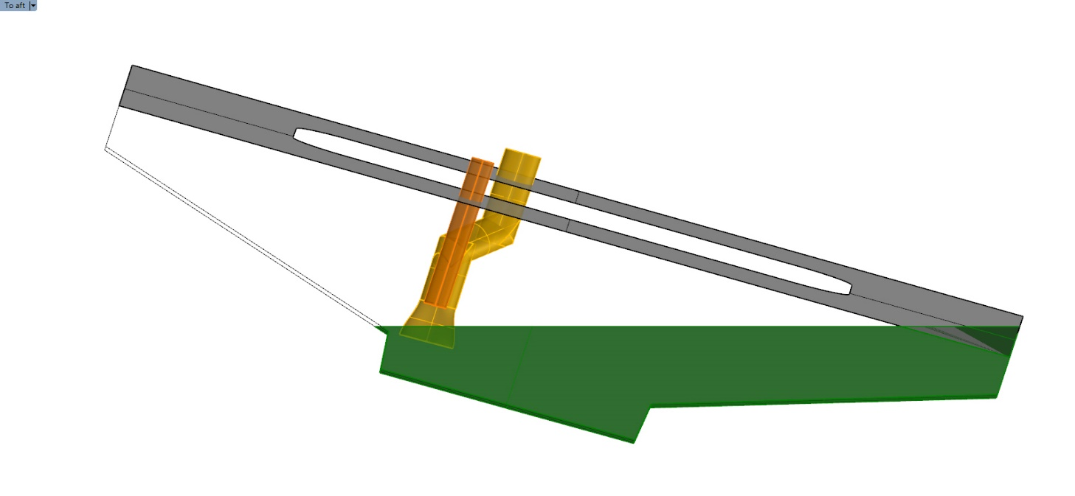
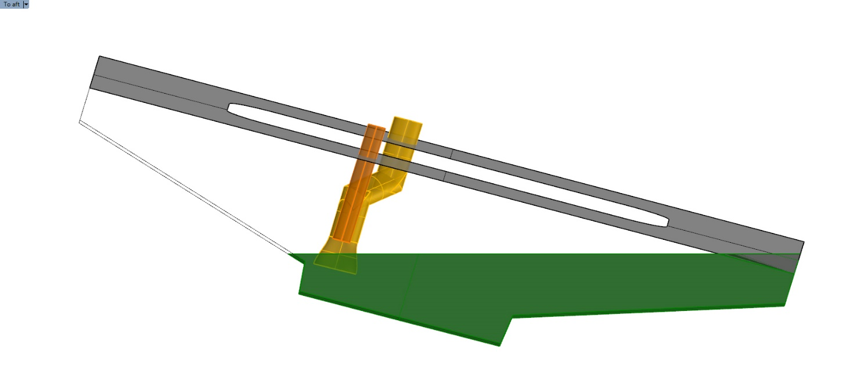

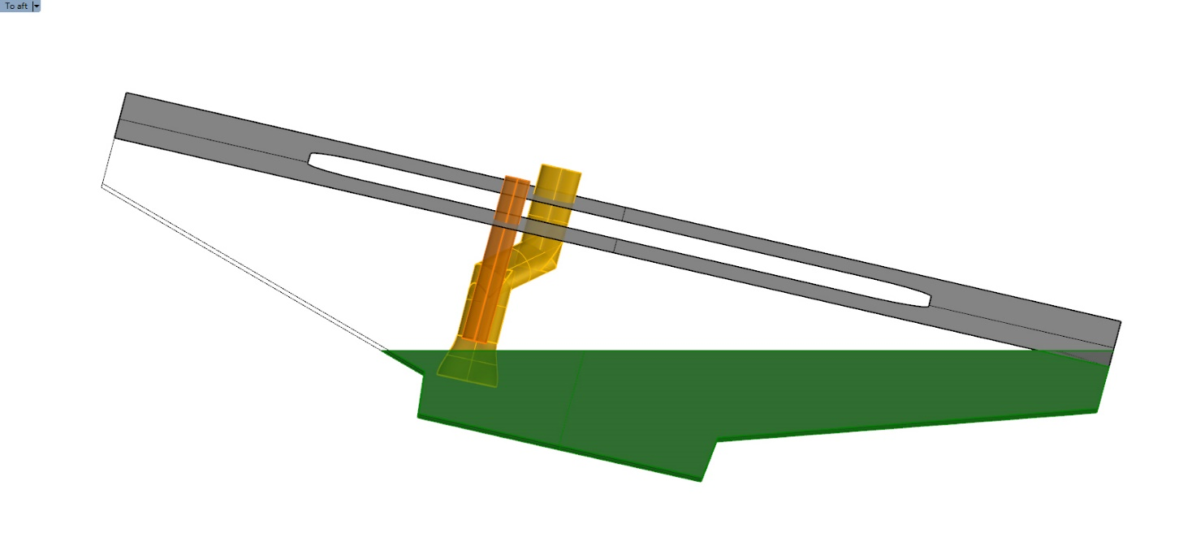
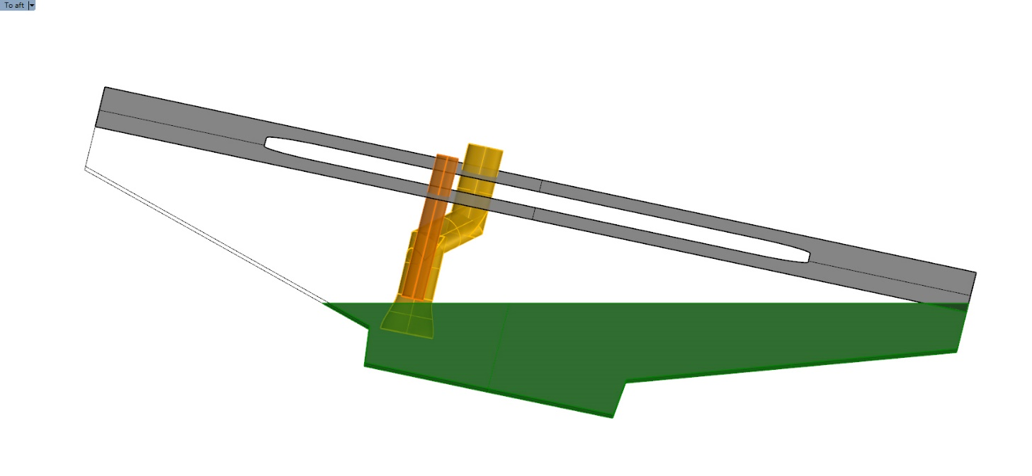
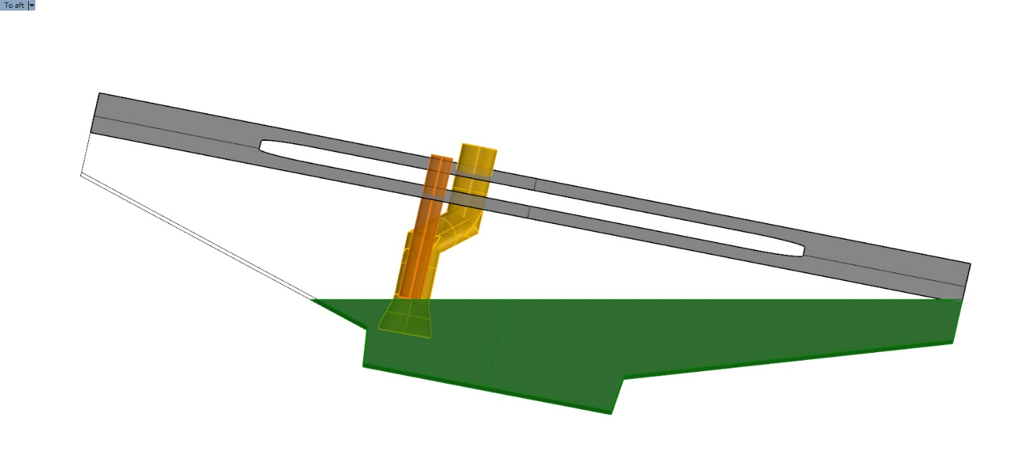
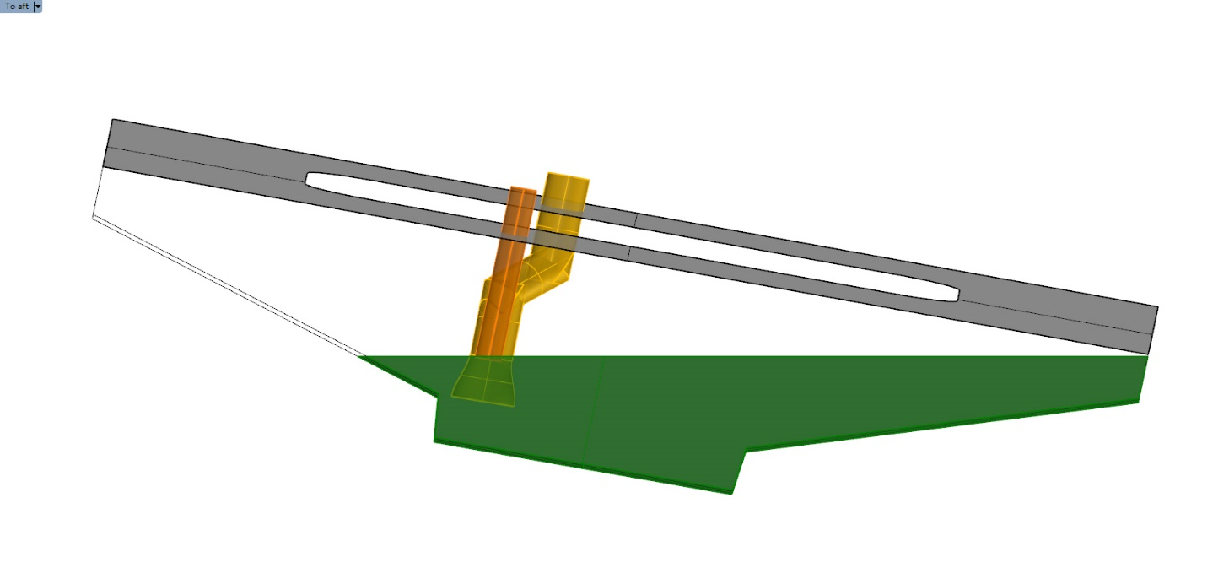
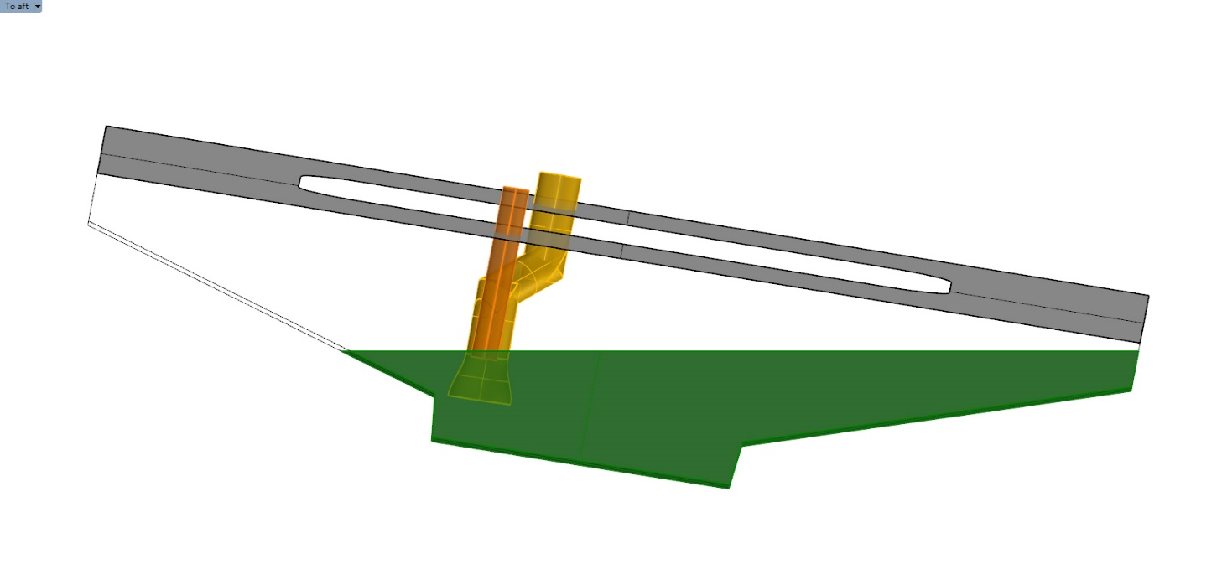
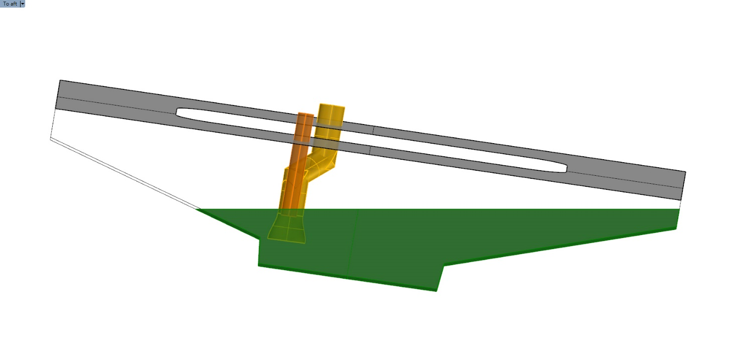









Click mouse or arrow on keyboard to start animation
LOSS OF PROPULSION ~ 0600
USCG MBI Simulation - Looking AFT
PORT List
0-20 degrees
Lube oil sump tank
LOOKING AFT

Slide 18
EL FARO Lessons Learned
Notes:
Mike Holt
Remarks on:
Focus on families
Assemble the Team
Jeff Bray
Remarks on:
Watertight integrity
Stability
General ACP issues
Third party oversight

Slide 19




Questions
Notes:
Suggested Moderator Questions
“Answer this question: ‘what I wasn’t expecting was . . .’”
“How would the investigation and civil litigation have been affected if we didn’t find the VDR?”
“What will be the enduring legacy of this tragedy?”
AUDIENCE QUESTIONS
END SHOW WITH NEXT SLIDE

Slide 20
In Memoriam
Louis Champa -- Palm Coast, Florida
Roosevelt Clark -- Jacksonville, Florida
Sylvester Crawford Jr. -- Lawrenceville, Georgia
Michael Davidson -- Windham, Maine
Brookie Davis -- Jacksonville, Florida
Keith Griffin -- Fort Myers, Florida
Frank Hamm -- Jacksonville, Florida
Joe Hargrove -- Orange Park, Florida
Carey Hatch -- Jacksonville, Florida
Michael Holland -- North Wilton, Maine
Jack Jackson -- Jacksonville, Florida
Jackie Jones, Jr. -- Jacksonville, Florida
Lonnie Jordan -- Jacksonville, Florida
Piotr Krause -- Poland
Mitchell Kuflik -- Brooklyn, New York
Roan Lightfoot -- Jacksonville Beach, Florida
Jeffrey Mathias -- Kingston, Massachusetts
Dylan Meklin -- Rockland, Maine
Marcin Nita – Poland
Jan Podgorski – Poland
James Porter -- Jacksonville, Florida
Richard Pusatere -- Virginia Beach, Virginia
Theodore Quammie -- Jacksonville, Florida
Danielle Randolph -- Rockland, Massachusetts
Jeremie Riehm -- Camden, Delaware
Lashawn Rivera -- Jacksonville, Florida
Howard Schoenly -- Cape Coral, Florida
Steven Shultz -- Roan Mountain, Tennessee
German Solar-Cortes -- Orlando, Florida
Anthony Thomas -- Jacksonville, Florida
Andrzej Truszkowski -- Poland
Mariette Wright -- St. Augustine, Florida
Rafal Zdobych -- Poland
Notes:
List verified

